Slide 1
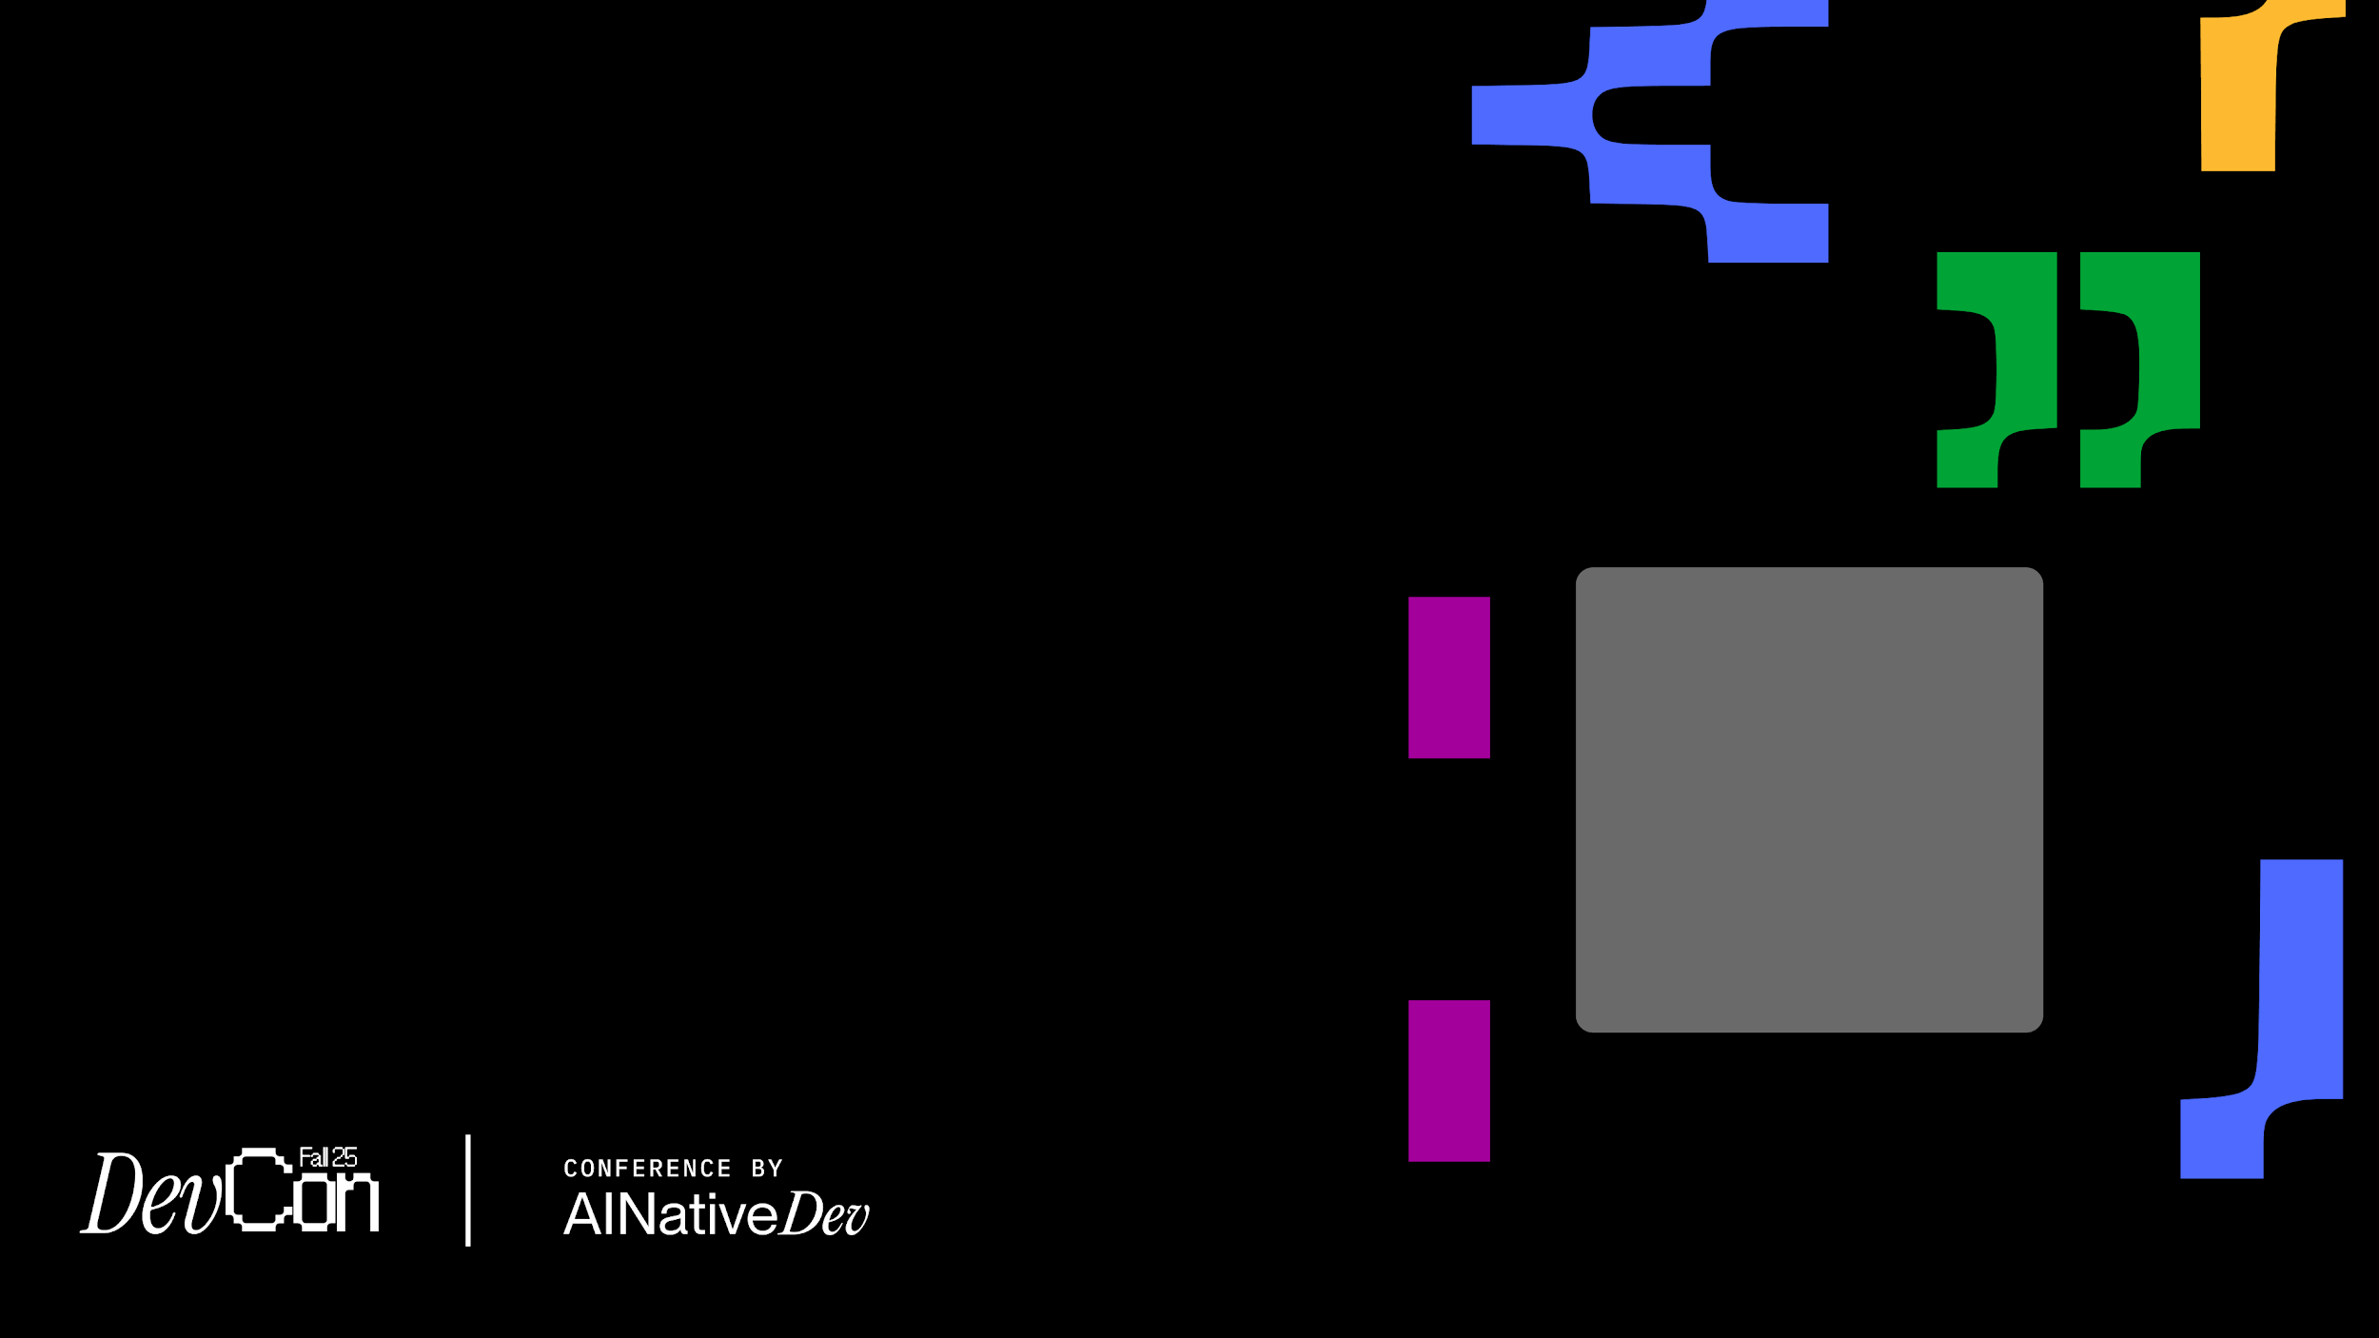

Emerging patterns
for coding with Generative AI
Lada Kesseler
Lead Developer

Slide 2






Developing software using Agentic Generative AI Tools
often
working software
hopefully working software
maybe
looks good
to me
“Coding with A Genie”
* Kent Beck

Slide 3
How do you control this??

Slide 4


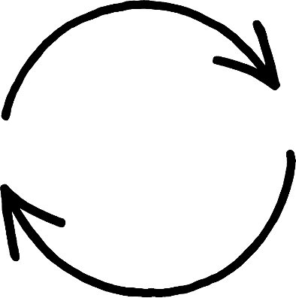



What can we even control here?
Developer
navigate
automate
Agentic Coding Tool
Claude Code Cursor
Codex
configure
choosing
give tools
in your environment
?
?
?
Foundation Model (LLM)
Gpt-5
Claude Opus 4.1
Gemini 2.5 Pro
choosing

Slide 5
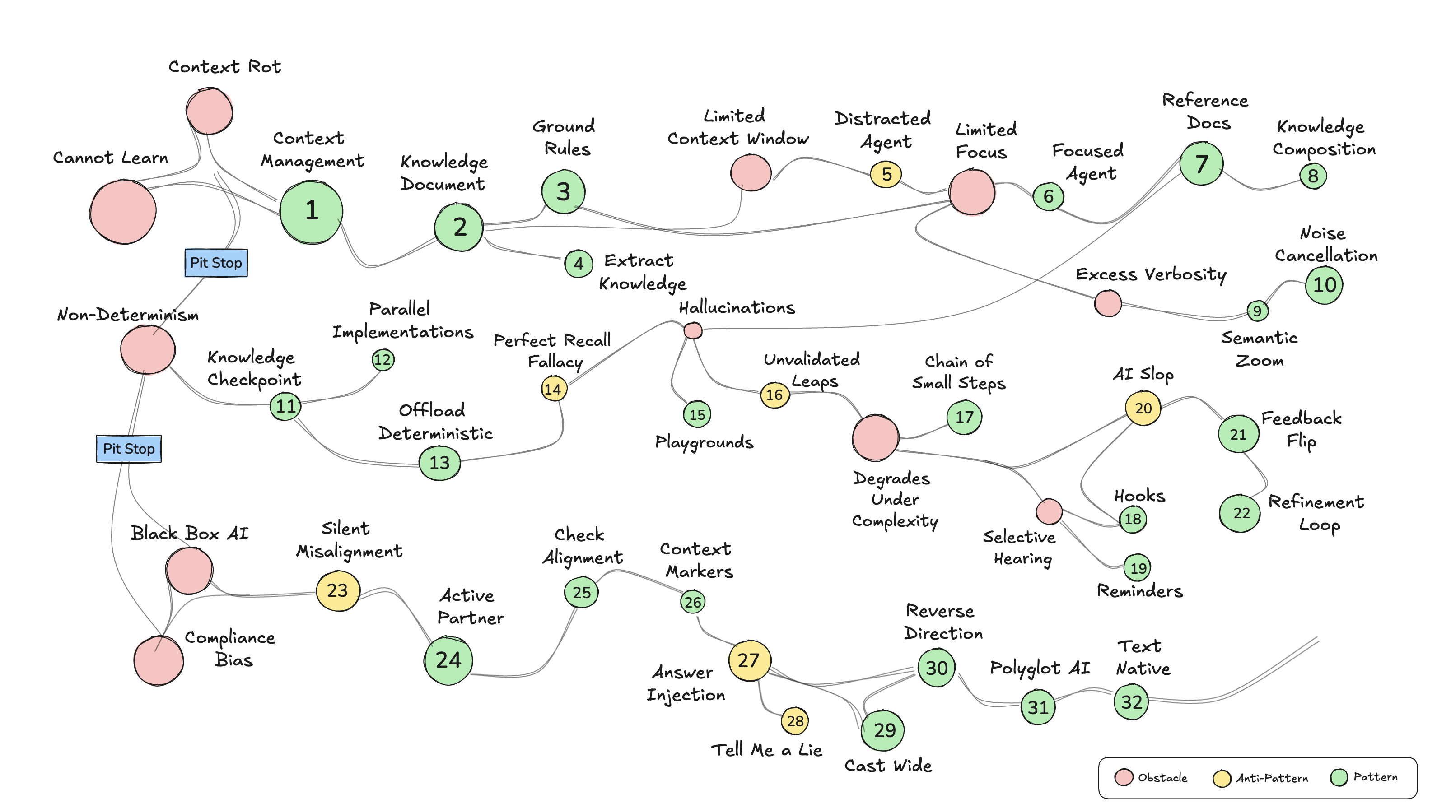

Slide 6
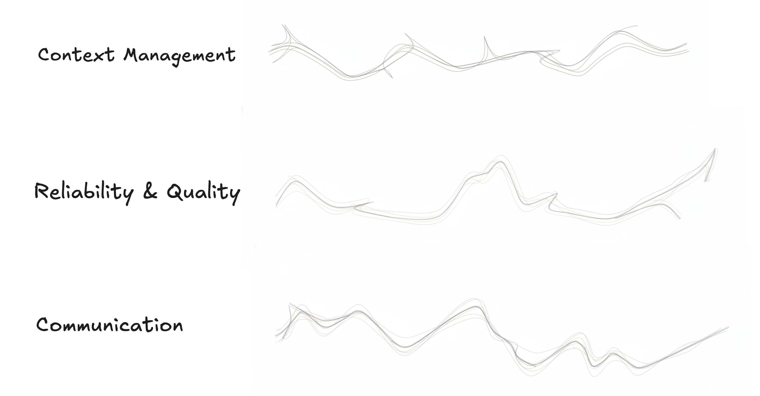
pit stop
pit stop

Slide 7


Resources
32
Lots of patterns!
Don’t panic!
They are all written down in the resources.
github.com/lexler/Talks/blob/main/augmented_coding_patterns_masterclass.md

Slide 8

Problem
LLM cannot learn from you
fixed model weights
it is stateless

Slide 9
What do we mean by stateless?
Memory is a lie

Slide 10
Talking to LLM via an API
Me: What’s 2 + 2?
Developer
AI: 4
Me: What’s is it in Portuguese?
Foundation Model (LLM)
AI: What’s what in Portuguese?
Me:
...

Slide 11

What you see
What AI sees
Context Window
What’s 2 + 2?
> What’s 2 + 2?
- 4
User: What’s 2 + 2?
AI: 4
User: What is it in Portuguese?
> What is it in Portuguese?
New prompt
- Still 4, dummy.
User: What’s 2 + 2?
AI: 4
User: What is it in Portuguese?
AI: Still 4, dummy.
Context Window –
current state
like string concatenation – context is immutable

Slide 12

Using those, what can we do to manage context?
Context Window
weights
fixed
context
unchangeable
cloneable
User: What’s 2 + 2?
AI: 4
User: What is it in Portuguese?
AI: Still 4, dummy.
User: What’s 2 + 2?
AI: 4
User: What is it in Portuguese?
AI: Still 4, dummy.
can add
cannot remove from
Append
Reset
manually or via tools

Slide 13
Problem
Context Rot
context degrades as conversation progresses
LLM stops following more and more of earlier instructions
it happens long before context window limit

Slide 14
focus
Context
Rot
effective context
goodness
rot
context window

Slide 15



pattern
#1) Context Management
Let’s start again!

Slide 17
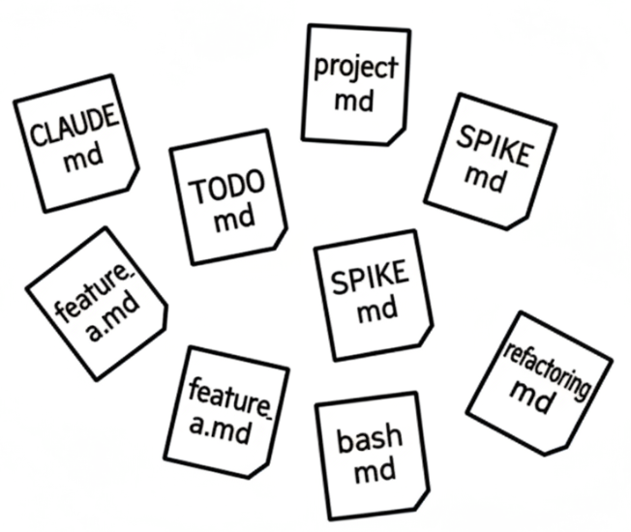
pattern
#2) Knowledge Document
save it to a file
Here’s how we do it: ...

Slide 18
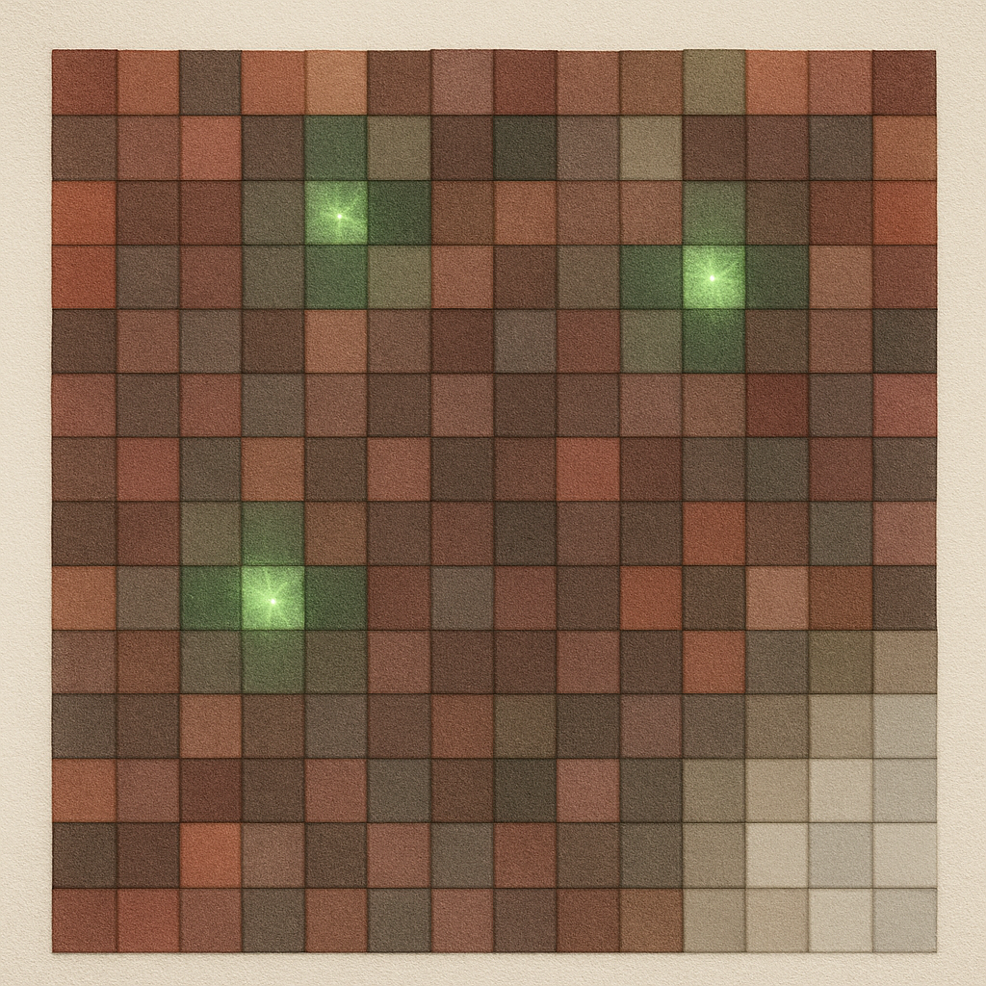

Here’s the important part of the conversation,
so I’m resetting and loading it

Slide 19
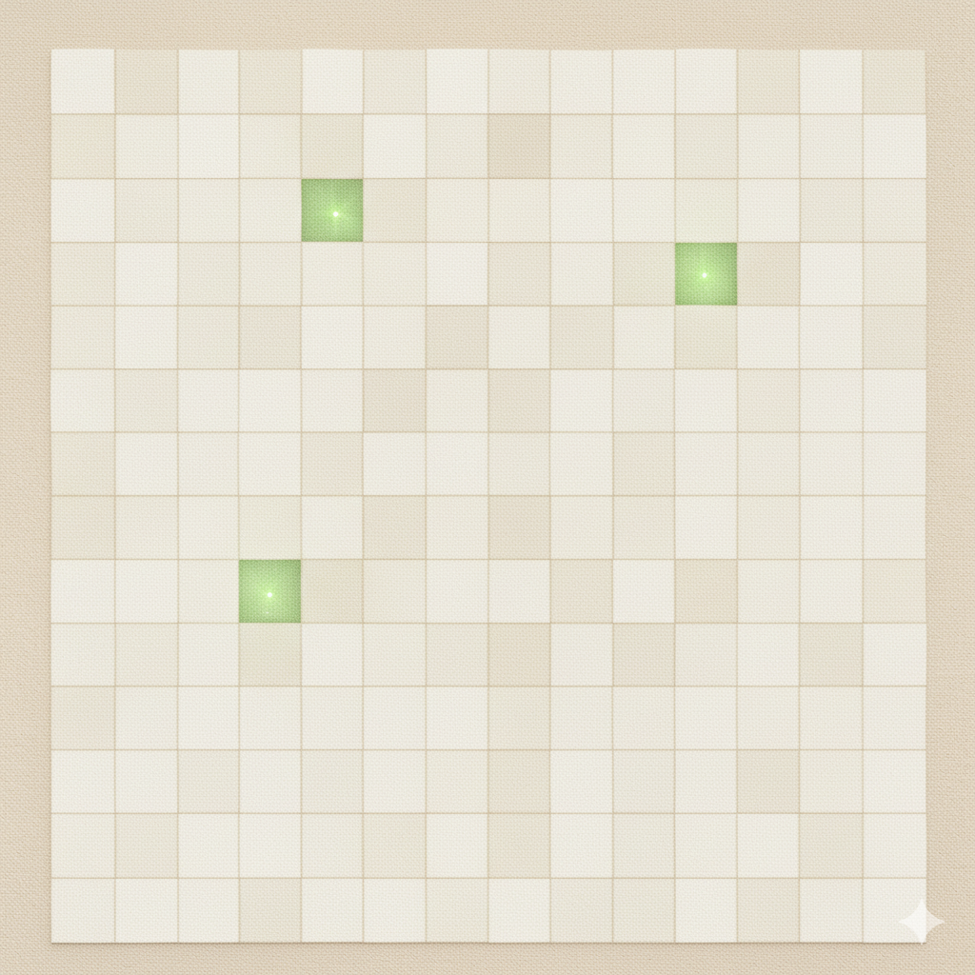
This would be nice!
reset conversation

Slide 20

knowledge.md
save the important parts
so I can reload it easily
reset
easier to hit reset

Slide 21
knowledge.md
“load important things”
reset

Slide 22
pattern
#3) Ground Rules
Always put the fire out before leaving camp!

Slide 23

Ground rules
always on
context window
Implementations:
ground rules
Genetric AGENTS.md
Claude Code CLAUDE.md Cursor .cursorrules
Windsurf .windsurf ...
user-level
or
project-level

Slide 24



pattern
#4) Extract Knowledge
save it to a file
Where was that thing we already talked about?...

Slide 25
knowledge.md
create
modify
“Hit save”

Slide 26
Can we put everything in one file?

Slide 27
Problem
Context window is limited
fixed size
first in, first out: oldest content gets erased
everything competes for limited space

Slide 28
Me: What’s 2 + 2?
AI: 4
Me: What’s 2 + 2 in Portuguese?
AI: Still 4, dummy.
User: Ha, ha. So funny.
Context Window
What’s 2 + 2?
4
What’s 2 + 2 in Portuguese?
Still 4, dummy.

Slide 29
Me: What’s 2 + 2?
AI: 4
Me: What’s is it in Portuguese?
AI: Still 4, dummy.
User: Ha, ha. So funny.
Context Window
What’s 2 + 2?
4
What’s is it in Portuguese?
Ha, ha. So funny.
Still 4, dummy.
dropped
whole conversation compressed
error out

Slide 30

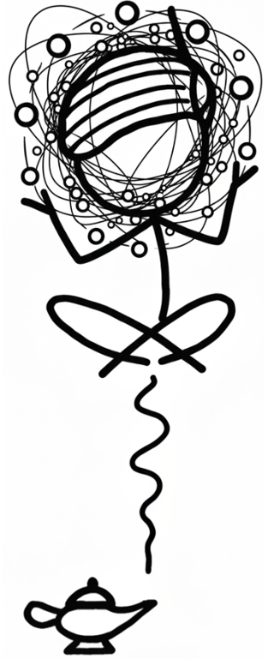
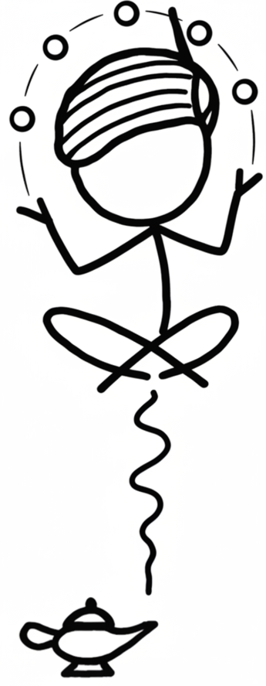
anti-pattern
#5) Distracted Agent
Look! A squirrel!

Slide 31
Be very honest. Tell me something I need to know even if I don't want to hear it*
Be proactive and flag issues before they become problems
* borrowed from Elisabeth Hendrickson

Slide 32


Claude Code
> commit
committed

Slide 33
commit
rules
Generalist
Specialist
same
size
dilutes attention across everything (shallow focus)
or fixates on the wrong parts

Slide 34
Problem
LLM has limited focus
does not equally prioritize every token

Slide 35

pattern
#6) Focused Agent
smaller scope == better results
One thing at a time!

Slide 36
Claude Code
Little Committer
Main
Claude
Code

Slide 37
I see you’re about to commit the entire node_modules directory. This is generally a bad practice as it bloats the repostitory.

Slide 38
The docs file has an underscore in its name instead of a hyphen.
Before committing, should I rename it to use hyphens for consistency?

Slide 39
There’s an issue with the PDF file
– it’s staged as new but also shows as deleted.
Should I unstage it or do you want to keep the file?

Slide 40
Specialist
commit
rules
narrow scope = way better instruction following

Slide 41
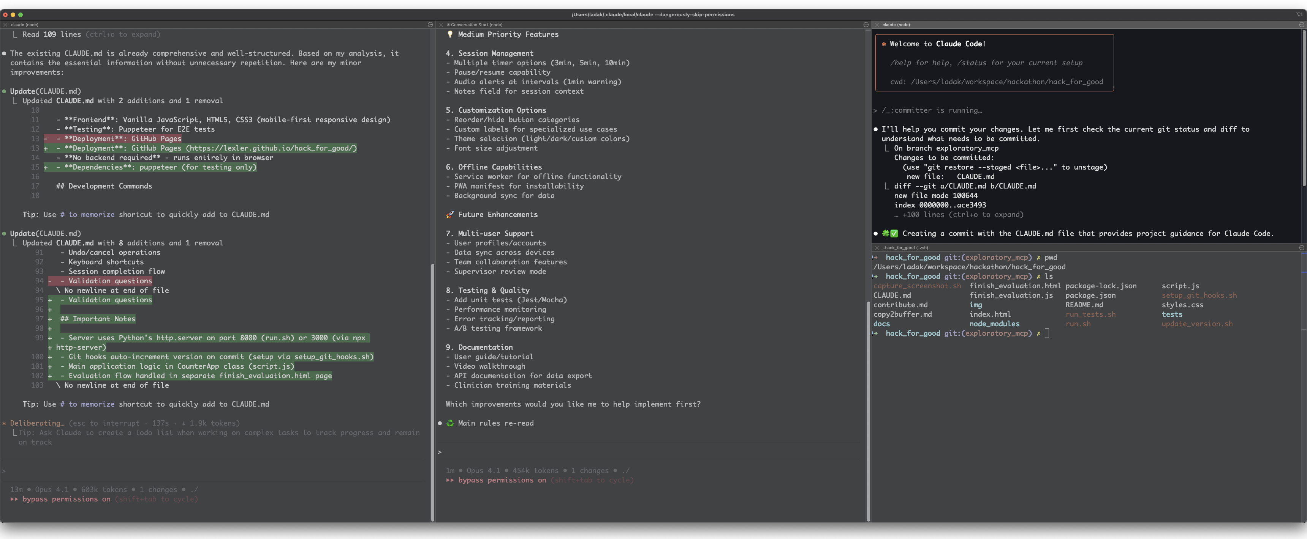
Claude Code
4 windows, where I am right now

Slide 42
Anything in your context
that is not being followed
is actively harmful

Slide 43
pattern
#7) References
It’s over there

Slide 44
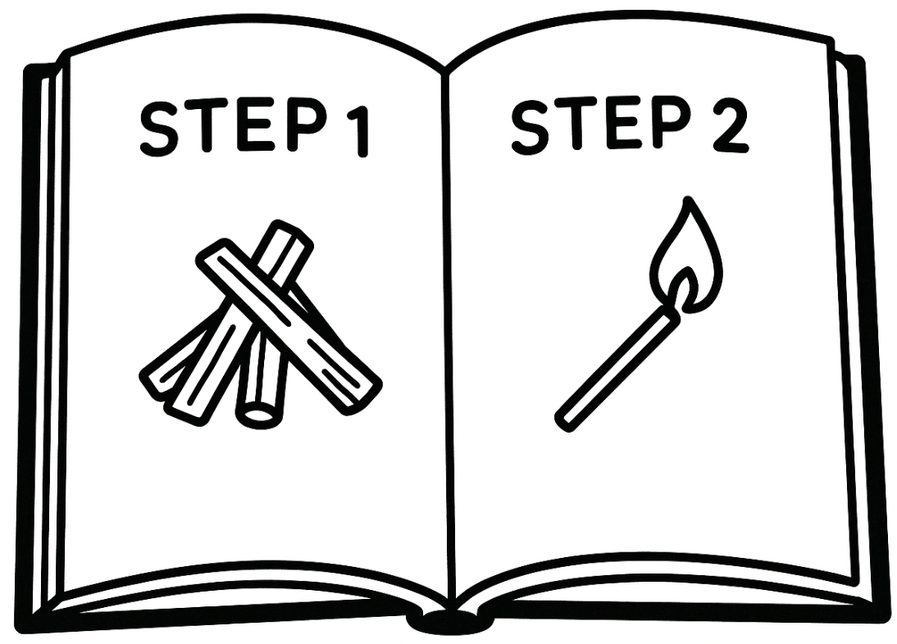
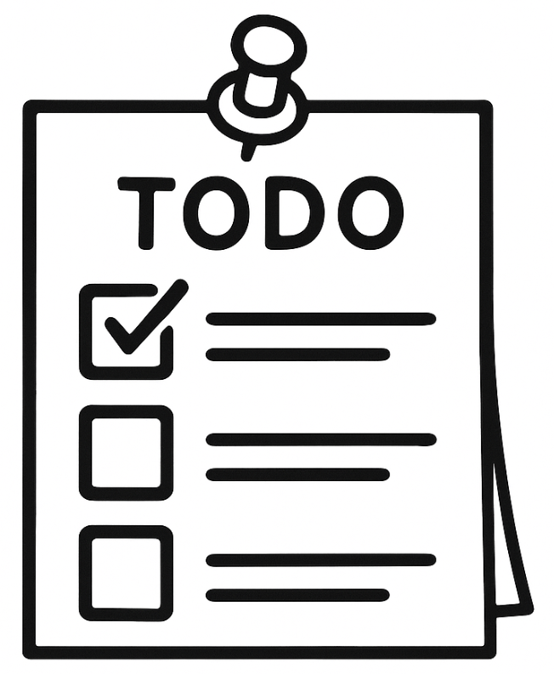

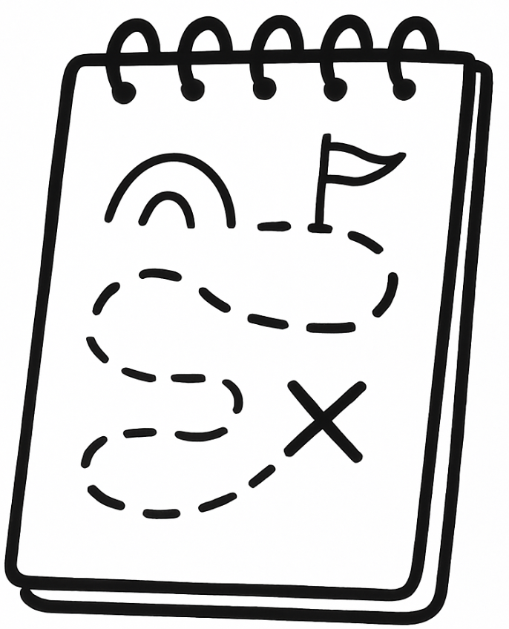

always on
as needed
Ground rules
Playbooks
prefer simple solutions!
TDD process
Maps
TODO lists
test.sh is in the root
Guides
Scratchpads
code_style.md

Slide 45

Reference Documents
context window
Guides
Knowledge
Playbooks
ground rules
python_style.md
bash_style.md
...
approval_tests.md
scrubbers.md
nullables.md
uv.md
...
TDD.process.md
refactoring.process.md
new_repo.process.md git_issue.process.md
...
how to use nullables
TDD process
Maps &
knowledge
TODOs &
scratchpads
test plan
project.md
architecture.md
map.md
technical_stack.md
test_plan.md
frontend_style.md
...
todo.md
spike.md
scratchpad.md
...

Slide 46
pattern
#8) Knowledge Composition

Slide 47
context window
project.md
ground rules
project info
project info
python style guide
python style guide
JS style guide
JS style guide
frontend test plan
frontend test plan
backend test plan
backend test plan
can’t pull out individual pieces

Slide 48
context window
frontend_test_plan.md
project.md
ground rules
frontend test plan
python_style_guide.md
frontend test plan
js_style_guide.md
backend_test_plan.md
just the test plan

Slide 50
Problem
AI is really noisy by default
How do you keep documents useful as the project grows?
Notes:
everyday is Day 1
LLM's stateless nature forces you to be a human copy-paste machine, repeatedly providing the same information.
stateless LLM – no recall of past sessions
limited context window size – memories overflow
static model weights
no learning from your prompts
you have to keep repeating peces

Slide 51
> What is cargo.toml and how is it used in rust?
> much more succinct please
Cargo.toml is the manifest file for Rust projects, similar to package.json in Node.js or pom.xml in Maven. It's a configuration file written in TOML (Tom's Obvious, Minimal Language) format that defines your project's metadata, dependencies, and build settings. Key sections in Cargo.toml: [package] - Basic project information: - name - Your project's name - version - Current version (follows seamantic versioning) - edition - Rust edition (2015, 2018, 2021) - authors - List of authors - description - Brief project description [dependencies] - External libraries (called "crates"): - Lists all third-party crates your project needs - Can specify versions, git repos, or local paths - Example: serde = "1.0" [dev-dependencies] - Dependencies only for development: - Used for testing, benchmarking, examples - Not included in final builds [build-dependencies] - Dependencies for build scripts [[bin]] or [[lib]] - Define binary or library targets How Cargo uses it: 1. Dependency Resolution: Cargo reads dependencies and downloads them from crates.io 2. Building: Uses settings to compile your code with correct flags 3. Version Management: Ensures compatible versions across dependencies 4. Project Structure: Defines where to find source files 5. Publishing: Contains metadata needed to publish to crates.io Without Cargo.toml, you can't use cargo commands like cargo build or cargo run - the project won't be recognized as a Cargo project.
Cargo.toml is Rust's project configuration file (like package.json for Node.js). It defines: - Project metadata: name, version, authors - Dependencies: external libraries your code needs - Build settings: how to compile your project Without it, you can't use cargo commands (cargo build, cargo run, etc.). It tells Cargo what to build and what dependencies to download from crates.io (Rust's package registry).
don’t care yet!
noise
don’t care yet!
level of detail matches
level of my curiosity
don’t care yet!
really, really don’t care

Slide 52
pattern
#9) Semantic Zoom
Text became elastic and really powerful

Slide 53
You can zoom in and out of text
Zoom in:
“Tell me more about...”
“What do you mean by...?”
“How do you write a...?”
deepen understanding
Zoom out:
“Make it shorter”
”Make it more succinct”
“Describe architecture on the high level”
“Give me a TLDR of this”
makes the meaning scannable

Slide 54

pattern
#10) Noise Cancellation
give instructions to fight the default LLM verbosity
7,.§§.88-.?+I?777.
.,..,CMDN?8§IO8?§
.,..,7ODEN§I8Z+OID
.NNDEN7EIZM+?O8+.
.,ZZD?E187DO§OIZ§
.:IOI§+§§I7OI+-.
,+?I7I?§O-+,
.??ZED§ID:..I-.
Let’s zoom out

Slide 55
Force succinctness
in knowledge documents
in responses to you
Delete mercilessly
use git as savepoint
Temporary throw away docs are helpful
todo.md
user_login_feature.md
scratchpad.md

Slide 56
Based on my exploration, Apache Kafka is a sophisticated distributed streaming platform with clear architectural layers. Here's the high-level
architecture:
┌───────────────────────────────────────────────────────────┐
│ CLIENT APPLICATIONS │
│ ┌──────────┐ ┌──────────┐ ┌──────────┐ ┌──────────┐ │
│ │Producer │ │Consumer │ │ Streams │ │ Connect │ │
│ └─────┬────┘ └────┬─────┘ └────┬─────┘ └────┬─────┘ │
└────────┼────────────┼─────────────┼─────────────┼─────────┘
│ │ │ │
▼ ▼ ▼ ▼
┌───────────────────────────────────────────────────────────┐
│ KAFKA BROKERS │
│ ┌──────────────────────────────────────────────────────┐ │
│ │ API Layer (KafkaApis) │ │
│ ├──────────────────────────────────────────────────────┤ │
│ │ ┌──────────┐ ┌──────────┐ ┌──────────┐ │ │
│ │ │ Replica │ │ Group │ │ Txn │ │ │
│ │ │ Manager │ │ Coord │ │ Coord │ │ │
│ │ └──────────┘ └──────────┘ └──────────┘ │ │
│ ├──────────────────────────────────────────────────────┤ │
│ │ Network Layer │ │
│ ├──────────────────────────────────────────────────────┤ │
│ │ ┌──────────┐ ┌──────────┐ ┌──────────┐ │ │
│ │ │ Log │ │ Metadata │ │ Raft │ │ │
│ │ │ Manager │ │ Store │ │Consensus │ │ │
│ │ └──────────┘ └──────────┘ └──────────┘ │ │
│ └──────────────────────────────────────────────────────┘ │
└───────────────────────────────────────────────────────────┘
│
▼
┌───────────────────────────────────────────────────────────┐
│ STORAGE LAYER │
│ Append-only logs, segments, indexes │
└───────────────────────────────────────────────────────────┘
Key architectural points:
1. Module Structure:
- /clients/ - Java client libraries (producer, consumer, admin)
- /core/ - Scala broker implementation
- /streams/ - Stream processing framework
- /connect/ - Data integration framework
- /raft/ - KRaft consensus (replacing ZooKeeper)
- /storage/ - Storage abstraction layer
2. Core Design:
- Pull-based model (consumers pull, not push)
- Immutable append-only logs
- Zero-copy data transfer
- Horizontal partitioning for scale
3. Coordination:
- Group coordinators manage consumer groups
- Transaction coordinators handle ACID guarantees
- Raft consensus for metadata (KRaft mode)
- Replica management for fault tolerance
The codebase shows a mature distributed system with clear separation between client libraries, broker core, stream processing, and storage layers.
The recent evolution toward KRaft (self-managed mode) removes the ZooKeeper dependency.
“Please look around and describe the architecture of the project to me on the highest level.
Use ASCII diagramming where appropriate”

Slide 57
Prevent it overloading you
Make docs manageable
Get answers to questions faster
In tests: keep up with AI
High level debugging

Slide 59
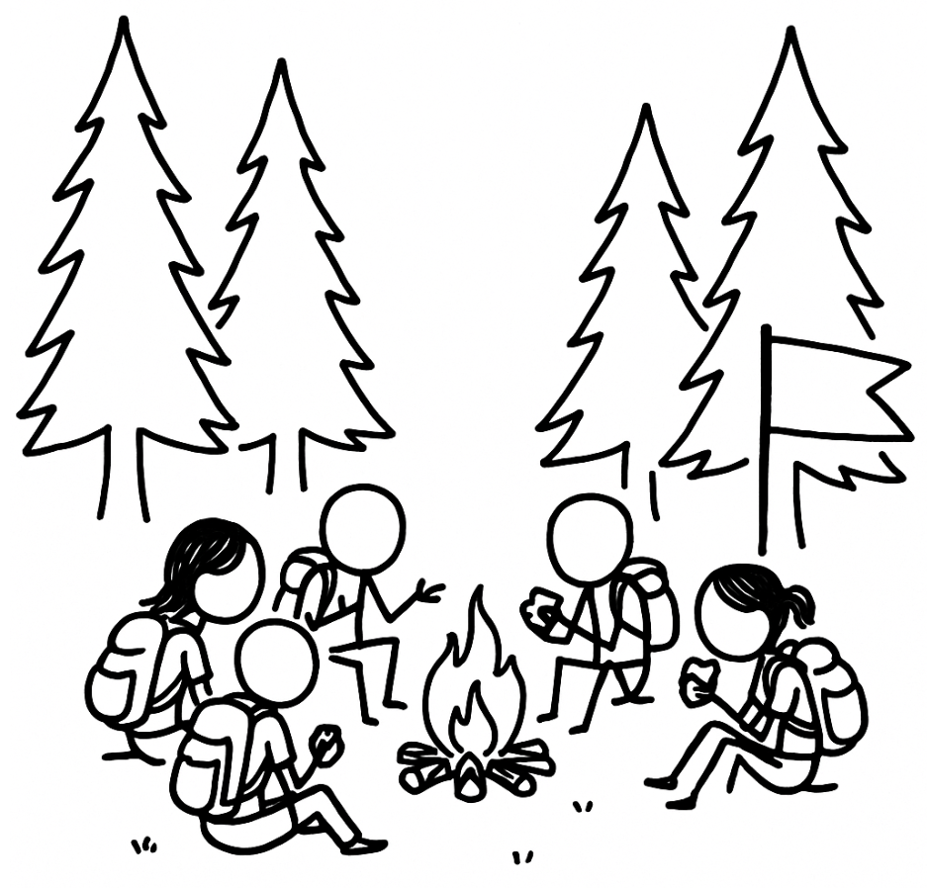
Stop 1/2
Questions so far?

Slide 60
Problem
AI is non-deterministic

Slide 61

pattern
#11) Knowledge Checkpoint
how do I go roll back?
OOPS!

Slide 62
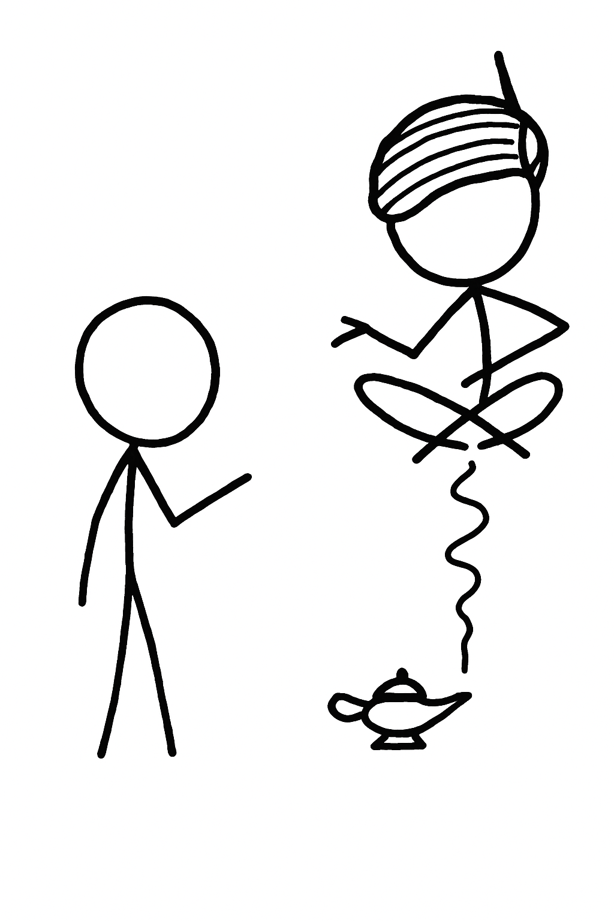




Without Knowledge Checkpoint
plan feature
implements
directly
FAILS
more time
needed
30 mins
getting to the same state
takes more time
time investment
scattered knowledge

Slide 63

Knowledge Checkpoint
feature_todo.md
edited
plan feature
save in markdown
git commit
implement
FAILS
30 mins
protect your time
investment in planning
time investment
try again or course correct
make it easy to roll back
< min
markdown file + git commit = Knowledge Checkpoint

Slide 64
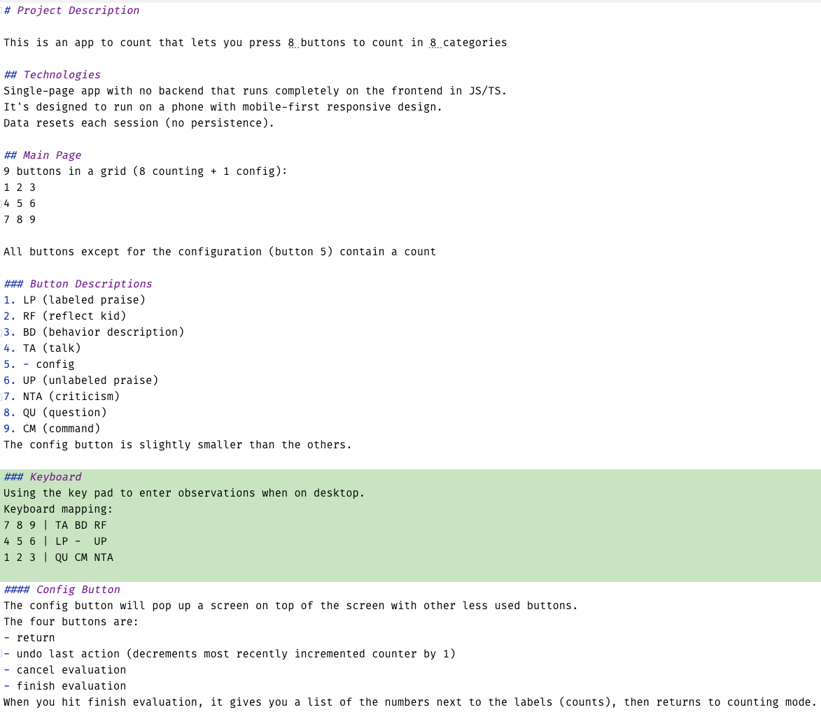
Example
1. “Save feature to project.md”
2. commit
3. Look at the last commit and implement the change

Slide 65
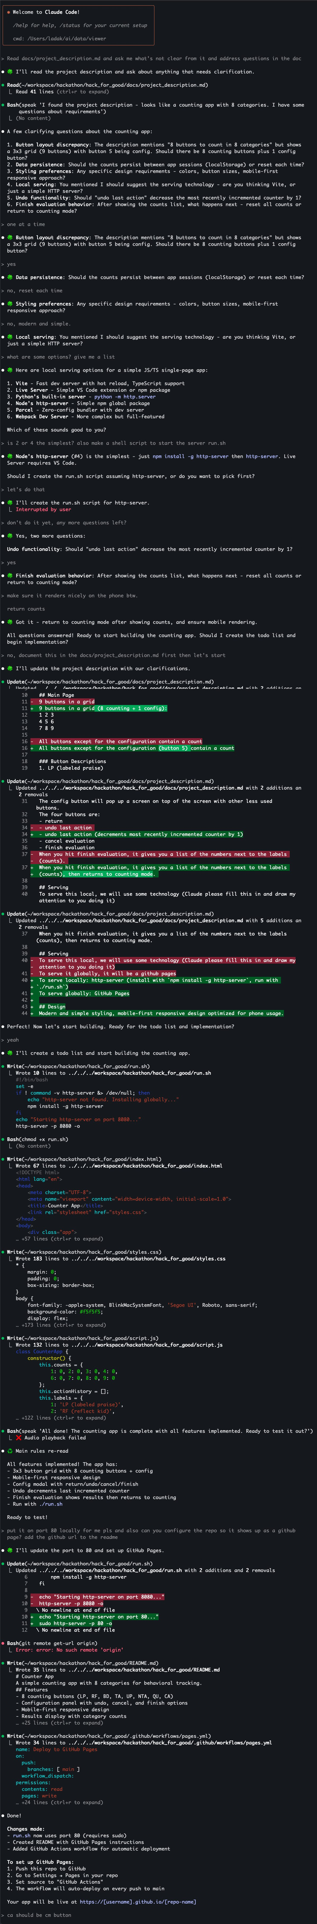

Slide 67

pattern
#12) Parallel Implementations
exploiting non-determinism
Let’s roll the dice!

Slide 68
Knowledge Checkpoint
feature_todo.md
edited
plan feature
save in markdown
git commit
implement
FAILS
30 mins
easy to roll back
time investment
markdown file + git commit = Knowledge Checkpoint

Slide 69
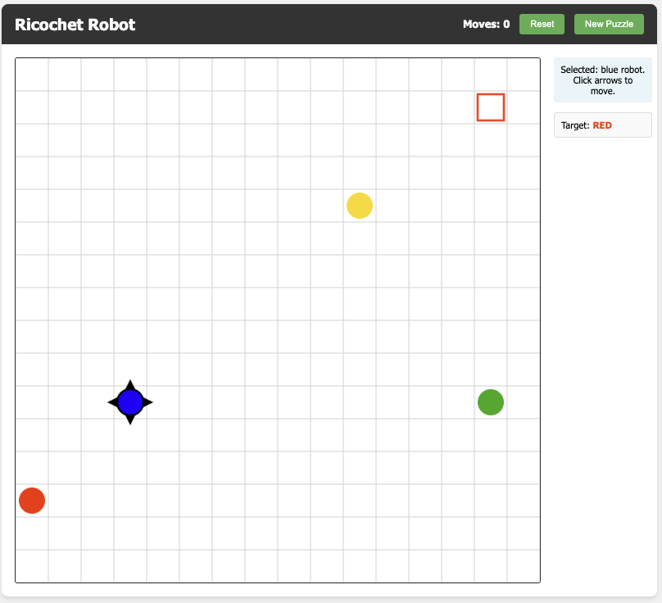

Slide 70
Parallel Implementations
git worktrees
project.md
todo.md
branch 1
plan feature
save in markdown
git commit
branch 2
30 mins
use bits
of both
branch 3

Slide 71
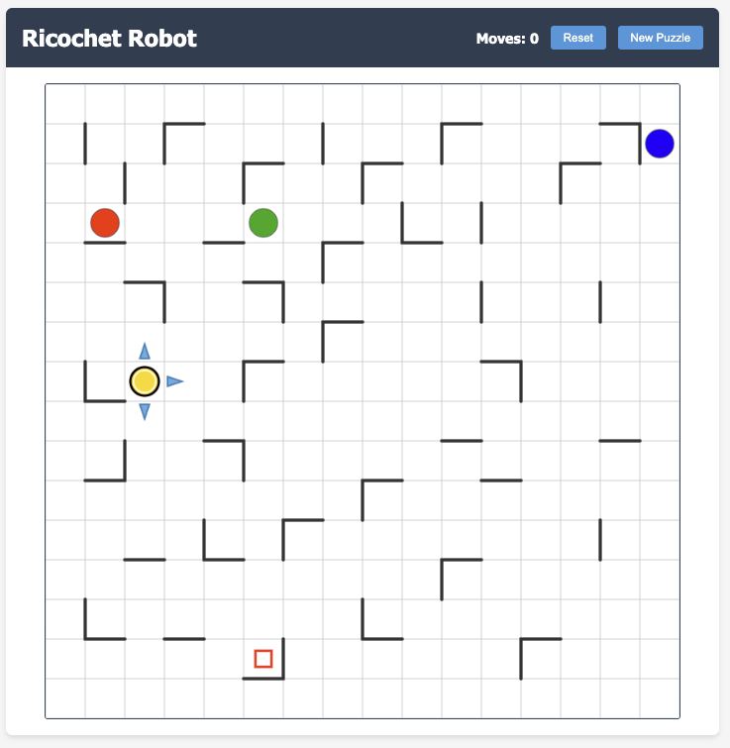
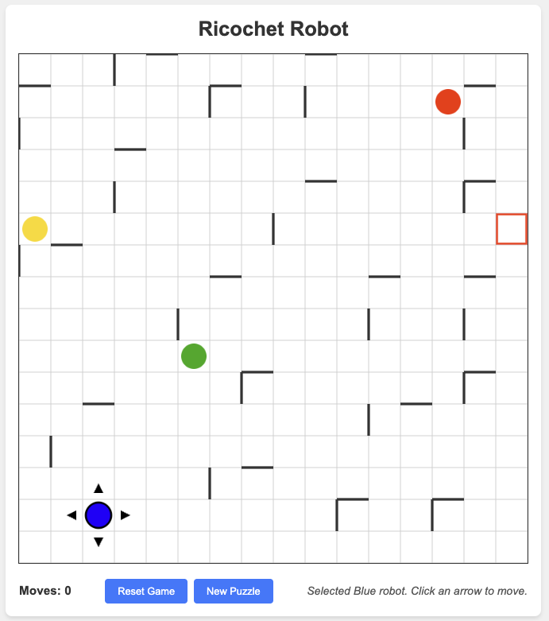

Slide 72
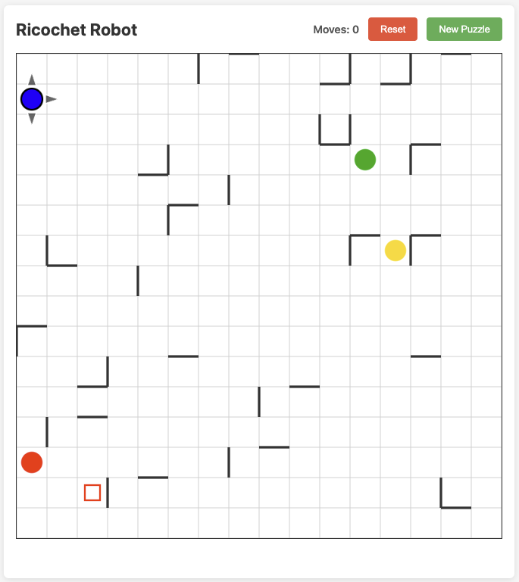
arrows + movement

Slide 73
pattern
#13) Offload Determinism
script everything that can be scripted
Notes:
Knowledge checkpoint creates stable reference points by combining validated documentation with git commits - you establish the truth in markdown, then lock it in version control so you can always return to that validated state

Slide 74
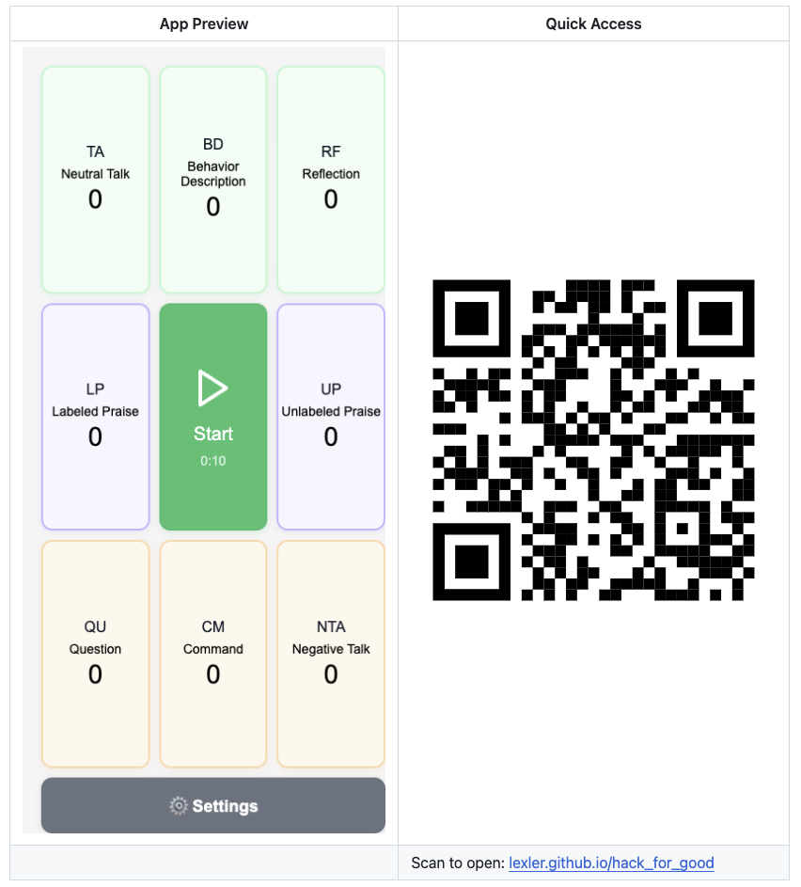

Slide 75
unreliable
“Take a screenshot of the current page using Puppeteer MCP”

Slide 76
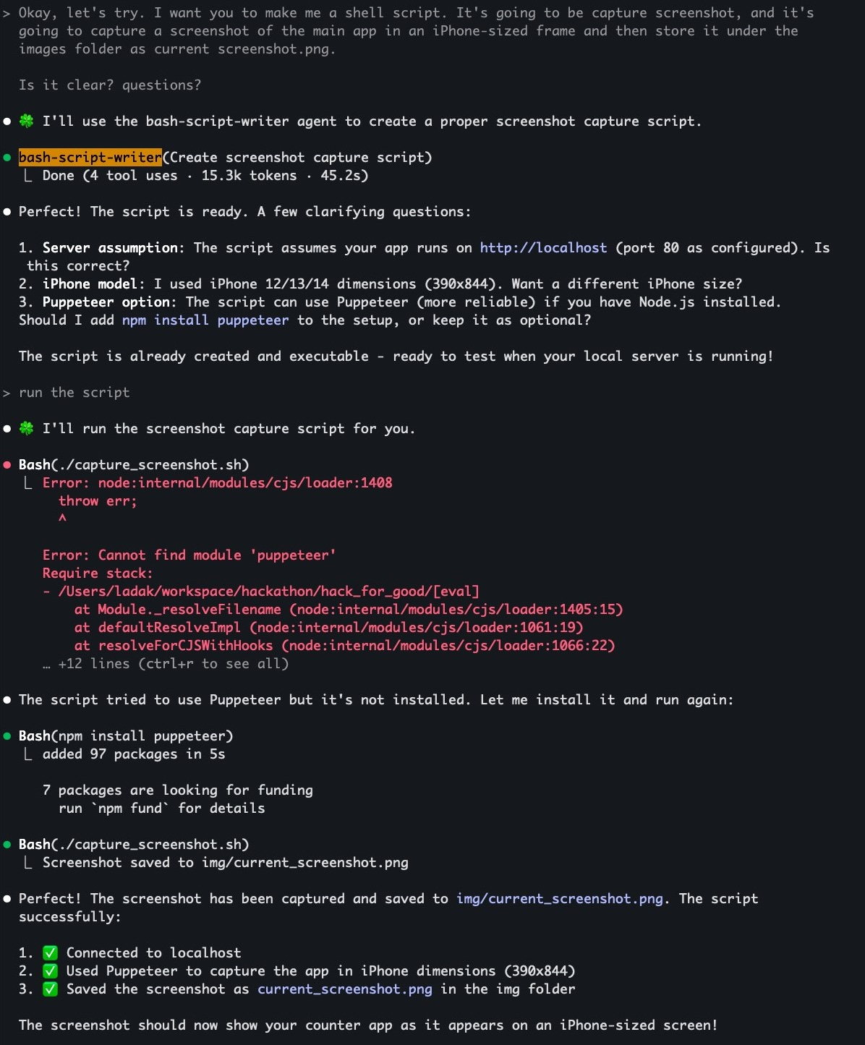


1

Slide 77
1

Slide 78
1

Slide 79
Created a tool
./capture_screenshot.sh
“run capture_screenshot.sh”

Slide 80
Example – Keeping Dependencies Updated
“We need to keep our project dependencies up to date. What are our options?”
manually update dependencies
AI
Dependabot or Renovate

Slide 81
Example - Linting
“We need to run linter and have common problems fixed”
ask AI to run linter and fix issues
git hook that runs linter automatically
auto-fix on (for safe fixes)

Slide 83
Problem
AI “hallucinates”
can confidently make things up
Notes:
we don’t know if it will succeed or fail

Slide 84
Code is self-verifiable

Slide 85
anti-pattern
#14) Perfect Recall Fallacy
AI is not a database

Slide 86
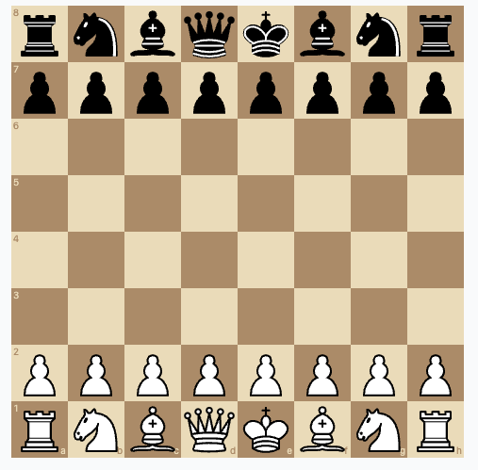
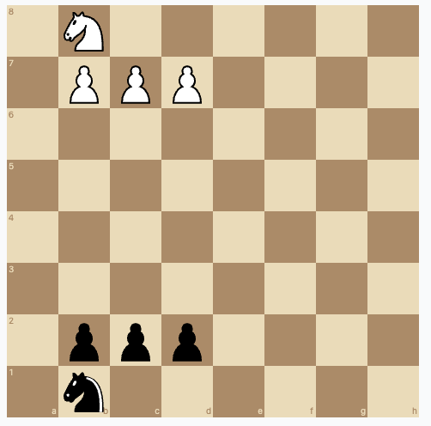
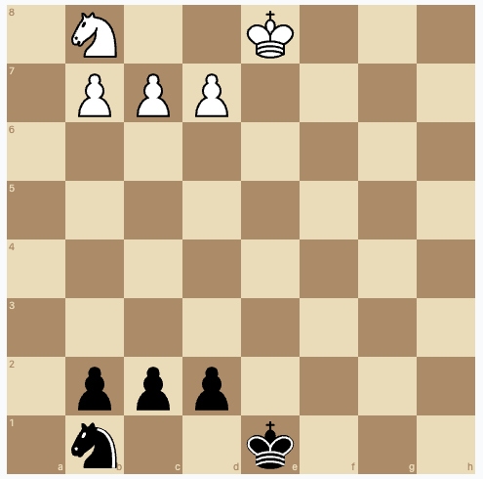
Problem: AI used library incorrectly
Regular Chess Board
We need flexible setup
chess.js requires kings to be present on the board

Slide 87
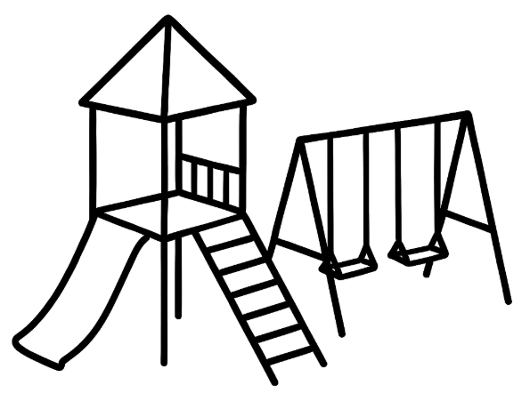
pattern
#15) Playgrounds
Notes:
Knowledge checkpoint creates stable reference points by combining validated documentation with git commits - you establish the truth in markdown, then lock it in version control so you can always return to that validated state

Slide 88
# Throw-Away Exploratory Code
When you run into a problem you didn't expect, write yourself some exploratory code piece to see what's going on.
Use 'playground' folder in the project, create it if doesn't exist and make sure it's in .gitignore
CLAUDE.md

Slide 89
Don’t expect AI to know details
give it reference documents
ask it to search
have it look at docs or tests
let it experiment
then make reference doc

Slide 90


anti-pattern
#16) Unvalidated Leaps

Slide 91
step A
step B
step C
step D
checks here
wrong assumption here
checks here
does not work

Slide 92
slow it down, validate each step
predictive TDD

Slide 93
Problem
AI struggles under complexity
Notes:
we don’t know if it will succeed or fail

Slide 94

pattern
#17) Chain of Small Steps
Can I take a smaller step?

Slide 95
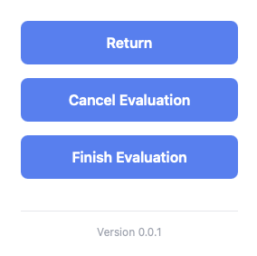

Slide 96
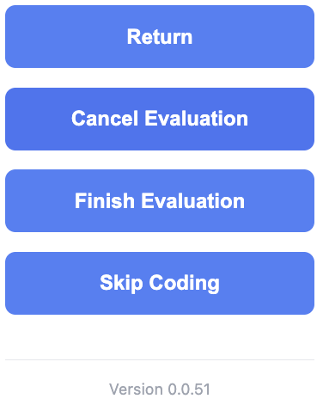

Slide 97
BAD
“Show the version number in the config and always increment it when we make a new feature”
Offload Deterministic

Slide 98
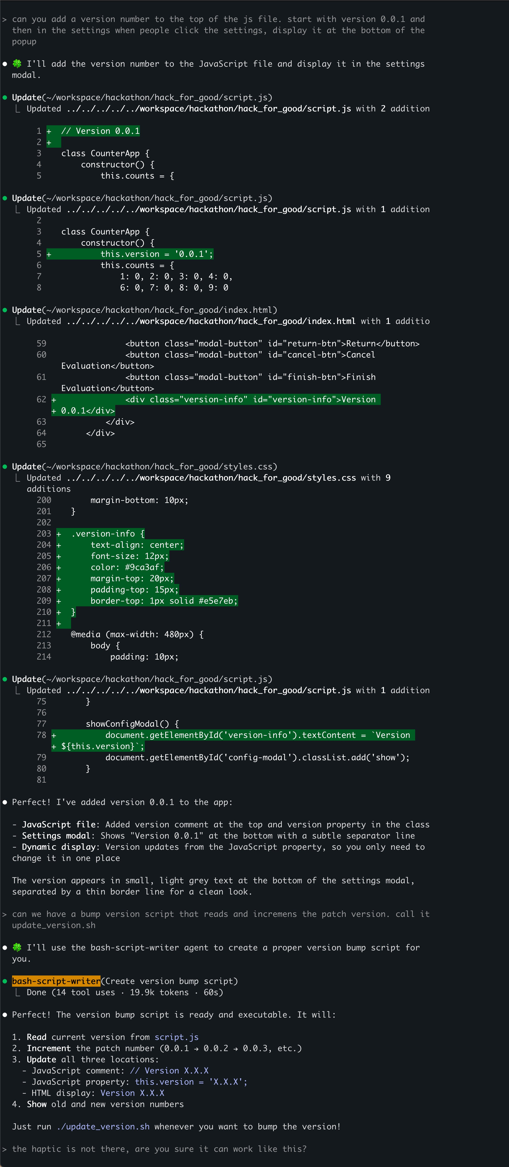
“Please add a version number”
add conversation
1

Slide 99
“Please add a version number”
add conversation
1

Slide 100
add version number
small change

Slide 101
“Please add a version number”
add conversation
1

Slide 102
“Please add a version number”
add conversation
1

Slide 103
update_version.sh
new!

Slide 104
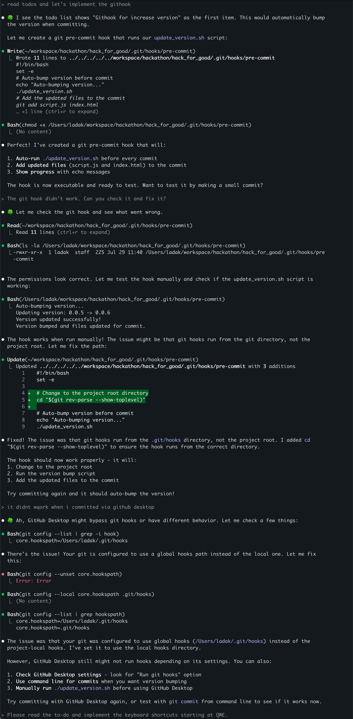
1

Slide 105
1

Slide 106
1

Slide 107
git commit hook
new!

Slide 108


version
number
update_
version.sh
githook

Slide 109
Patterns Used
Chain of Small Steps
Offload Deterministic
Focused Agent
Knowledge Checkpoint

Slide 110
Problem
Selective Hearing

Slide 111
Tricky instructions
stripped out ground rules to the most important things
narrowed the scope
some rules are still not being followed

Slide 112
Two types of stubornness
agent training
getting distracted
Just let it do it. Then automate taking it out
Focus it
Remind it of what’s important
Examples
Fighting hallucinations with whisper voice model
Stopping code comments

Slide 113
pattern
#18) Hooks
use force
I warned you!

Slide 114
Developer
Claude Code Lifecycle Events
UserPromptSubmit
PreToolUse
PostToolUse
Notification
Stop
SubagentStop
PreCompact
SessionStart
SessionEnd
memory
Agent
tools
LLM
/hooks

Slide 115
> Make me a Python script that outputs a string on the console. put it into hello world file
⏺ 🍀 I'll create a Python script that outputs a string to the console and save it as hello_world.py.
⏺ Done! Created hello_world.py with a simple print statement.
> try to add a comment about what that line does into that file
⏺ 🍀 I'll add a comment to explain what that line does.
⏺ Update(hello_world.py)
⎿ Updated hello_world.py with 1 addition
1 + # This line prints a greeting message to the console
2 print("Hello, World!")
3 \ No newline at end of file
> PostToolUse:Edit operation feedback:
- [/Users/ladak/ai/lexler/claude-code-tools/.claude/hooks/enforce-no-comments-on-edit/enforce_no_comments_hook.py]: {"continue": false, "stopReason": "\u274c Comments detected in hello_world.py:\n/Users/ladak/workspace/talk_prep/hello_world.py:1 - # This line prints a
greeting message to the console\n\nPlease remove comments before continuing."}
⏺ 🍀 I'll remove the comment to comply with the hook's requirements.
⏺ Update(hello_world.py)
⎿ Updated hello_world.py with 1 removal
1 - # This line prints a greeting message to the console
1 print("Hello, World!")
2 \ No newline at end of file
⏺ Done! The comment has been removed from hello_world.py

Slide 116
pattern
#19) Reminders
nagging
Did you take the garbage out?
Did you take the garbage out?
Did you take the garbage out?

Slide 117
Lightweight Enforcing
TODOs
Instruction Sandwitch
User Reminders (automated)

Slide 118
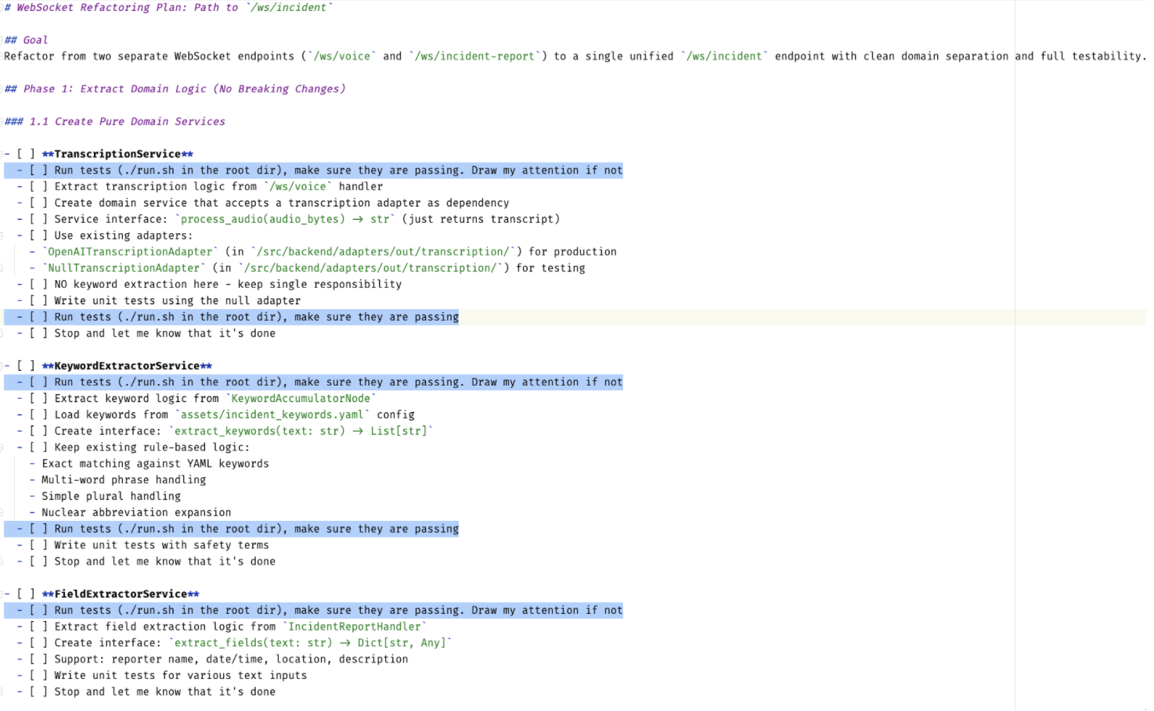
run tests
run tests
TODO.md
run tests
run tests

Slide 119
Automating Reminders
reminders = [
"🤝 Exercise full agency to push back on mistakes. Flag issues early, ask questions if unsure of direction instead of choosing randomly",
"🤲 Don't flatter me. Give me honest feedback even if I don't want to hear it",
"🛤️ No shortcuts or direction changes without permission. Ask with❓emoji when changing course",
"❓ If you need to ask me a list of questions, show me the list and then start asking one question at a time"
]
Claude Code Reminder Hook
https://github.com/lexler/claude-code-user-reminders

Slide 121
anti-pattern
#20) AI Slop

Slide 122
AI Slop Recipe
prompt AI
lightly edit (optional)
present as your work
common spaces become useless, people tune out or leave
we can’t stop it, but we can choose not to add to it

Slide 123
AI Slop in Code?
no guardrails single prompting
ship it!
don’t expect single pass to produce good code

Slide 124
pattern
#21) Feedback Flip
Do you see any problems with this?

Slide 125
First Variation
Coding Agent A
Coding Agent B (same or different LLM)
>
>
Coder
Reviewer
1. Given a task, implement it
2. Given task and diff, suggest improvements
3. Apply improvements

Slide 126
Second Variation
Coding Agent A
>
1. Given a task, implement it
2. Given task and diff, suggest improvements
Coder
3. Apply improvements
?
?
Why does this work?
?
Theory:
- only enough focus for solving main task
- at cost of everything else
- refocusing == new main task

Slide 127
pattern
#22) Refinement Loop
Nice. Let’s take it to 11!

Slide 128
Can we do better?
single pass == usually poor results
even adding one feedback loop is way better
what if we loop it & generalize?

Slide 129
# TDD Production Code Refactoring Process
**ALWAYS** ask the user one question at a time and wait for a response.
**ALWAYS** confirm file names and locations if unsure.
**NEVER** make changes to Test code in this process.
This process is for refactoring production code.
## Steps
Confirm the relevant test file and its location before starting.
- For each refactor:
1. Ensure all tests pass.
2. Choose and perform the simplest possible refactoring (one at a time).
3. Ensure all tests pass after the change.
4. Commit each successful refactor with the message format: "- r <refactoring>" (quotes must include the - r).
5. Provide a status update after each refactor.
- If a refactor fails three times or no further refactoring is found, pause and check with the user.
## Code Style
- Prefer self-explanatory, readable code over comments.
- Use functional helper methods for clarity.
- Prefer `org.lambda.query.Queryable` over Java streams.
- Remove comments and dead code.
- Extract paragraphs into methods.
- Use better variable names.
- Remove unused imports.
- Remove unhelpful local variables
goal
take one step towards the goal. simplest
makes iterative
solves: surface problems obscure deeper ones
* Llewellyn Falco

Slide 130
Refinement Loop
1. Define your goal
Can be many things!
refactor code
improve quality
simplify
get to the gist of the idea
2. AI makes one pass towards that goal
recommend simplest
3. Save intermediate steps to a file or commit
enforces iteration
4. Repeat until AI sees nothing to improve
now ready for human’s feedback

Slide 132
Stop 2/2
Questions so far?

Slide 134
Problem
AI internals are hidden
misalighment between human and AI “Mental Model”
hard to detect
Notes:
we don’t know if it will succeed or fail

Slide 135
Problem
Compliance Bias
LLM will do almost anything you ask it to do
Notes:
we don’t know if it will succeed or fail

Slide 136
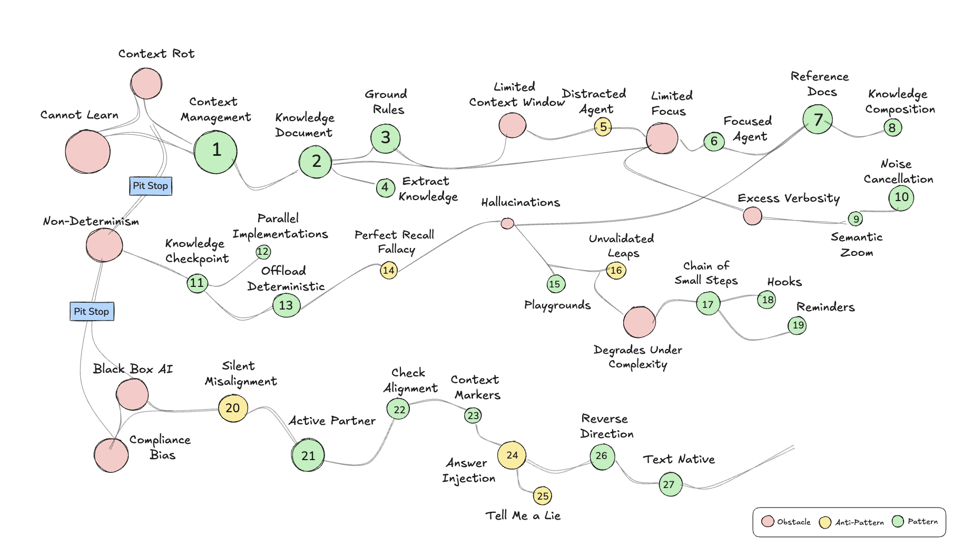

Slide 137
anti-pattern
#23) Silent Misalighnment

Slide 138



Slide 139
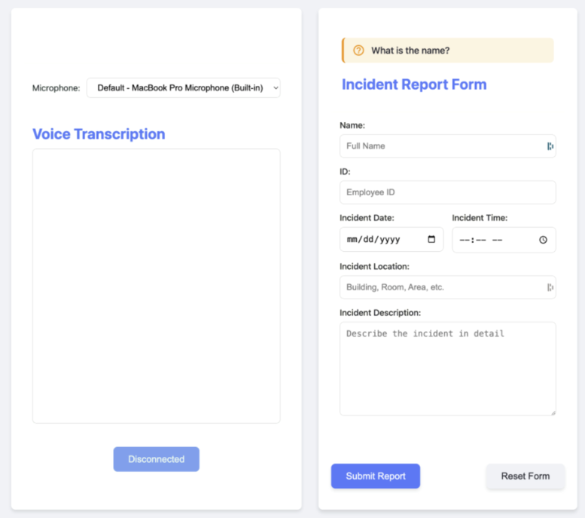
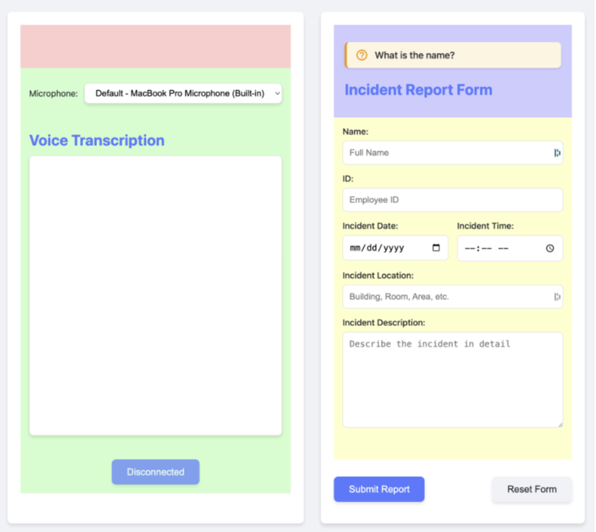

Slide 140
Was hard to even suspect mental model differences
Why didn’t it tell me that I wasn’t making any sense?

Slide 141
pattern
#24) Active Partner
Let’s work together

Slide 142
Tell me something I need to know even if I don't want to hear it

Slide 143
Push back when something seems wrong - don't just agree with mistakes

Slide 144
Ask questions if something is not clear and you need to make a choice.
Don't choose randomly if it's important for what we're doing

Slide 145
When you show me a potential error or miss,
start your response with❗️emoji

Slide 146
Enforcing Paternership
Global Rules
Impromptu Prompting
honest feedback
what do you think of this piece? give me honest feedback even if I don’t want to hear it
permission to disagree
do you have any questions?
proactively point out mistakes
is everything clear?

Slide 147
pattern
#25) Check Alignment

Slide 148
request
implements
FAILS
it misunderstood
20 mins
wasted

Slide 149
Show me current architecture and
what you plan to change, succinctly

Slide 150
request
implements the right thing
misunderstanding
caught early

Slide 152
pattern
#26) Context Markers

Slide 153
CLAUDE.md
**ALWAYS** start replies with STARTER_CHARACTER + space (default: 🍀).
Stack emojis when requested, don't replace.
> what's 2 + 2?
- 🍀 4

Slide 154
**ALWAYS** start replies with STARTER_CHARACTER + space (default: 🍀).
Stack emojis when requested, don't replace.
CLAUDE.md
You're a committer. Work with me like this:
- add ✅ to STARTER_CHARACTER emojis
...
committer.md
> commit
✅🍀 Let me check what changes need to be committed.
⎿ On branch main
Untracked files:
(use "git add <file>..." to include in what will be committed)
… +3 lines (ctrl+o to expand)
⎿ (No content)

Slide 155
TDD Production Code Refactoring Process
STARTER_CHARACTER = 🟣
- 🟣 I understand the TDD production code refactoring process. I'm ready to help refactor your code following these steps:
1. Confirm test file location
2. Ensure tests pass
3. Make simple, atomic refactorings
4. Verify tests after each change
5. Commit with "- r " format
6. Provide status updates
Please share the code you'd like me to refactor, and I'll start by confirming the relevant test file location.

Slide 156
## Examples - 🍀 = default mode active - 🔴/🌱/🌀 = TDD phase (red/green/refactor)
- 🟣 refactoring process - ✅ = committer role active - ❗️ = flagging an error - ♻️ = rules just re-read - ✨📂 = creating new repository

Slide 157
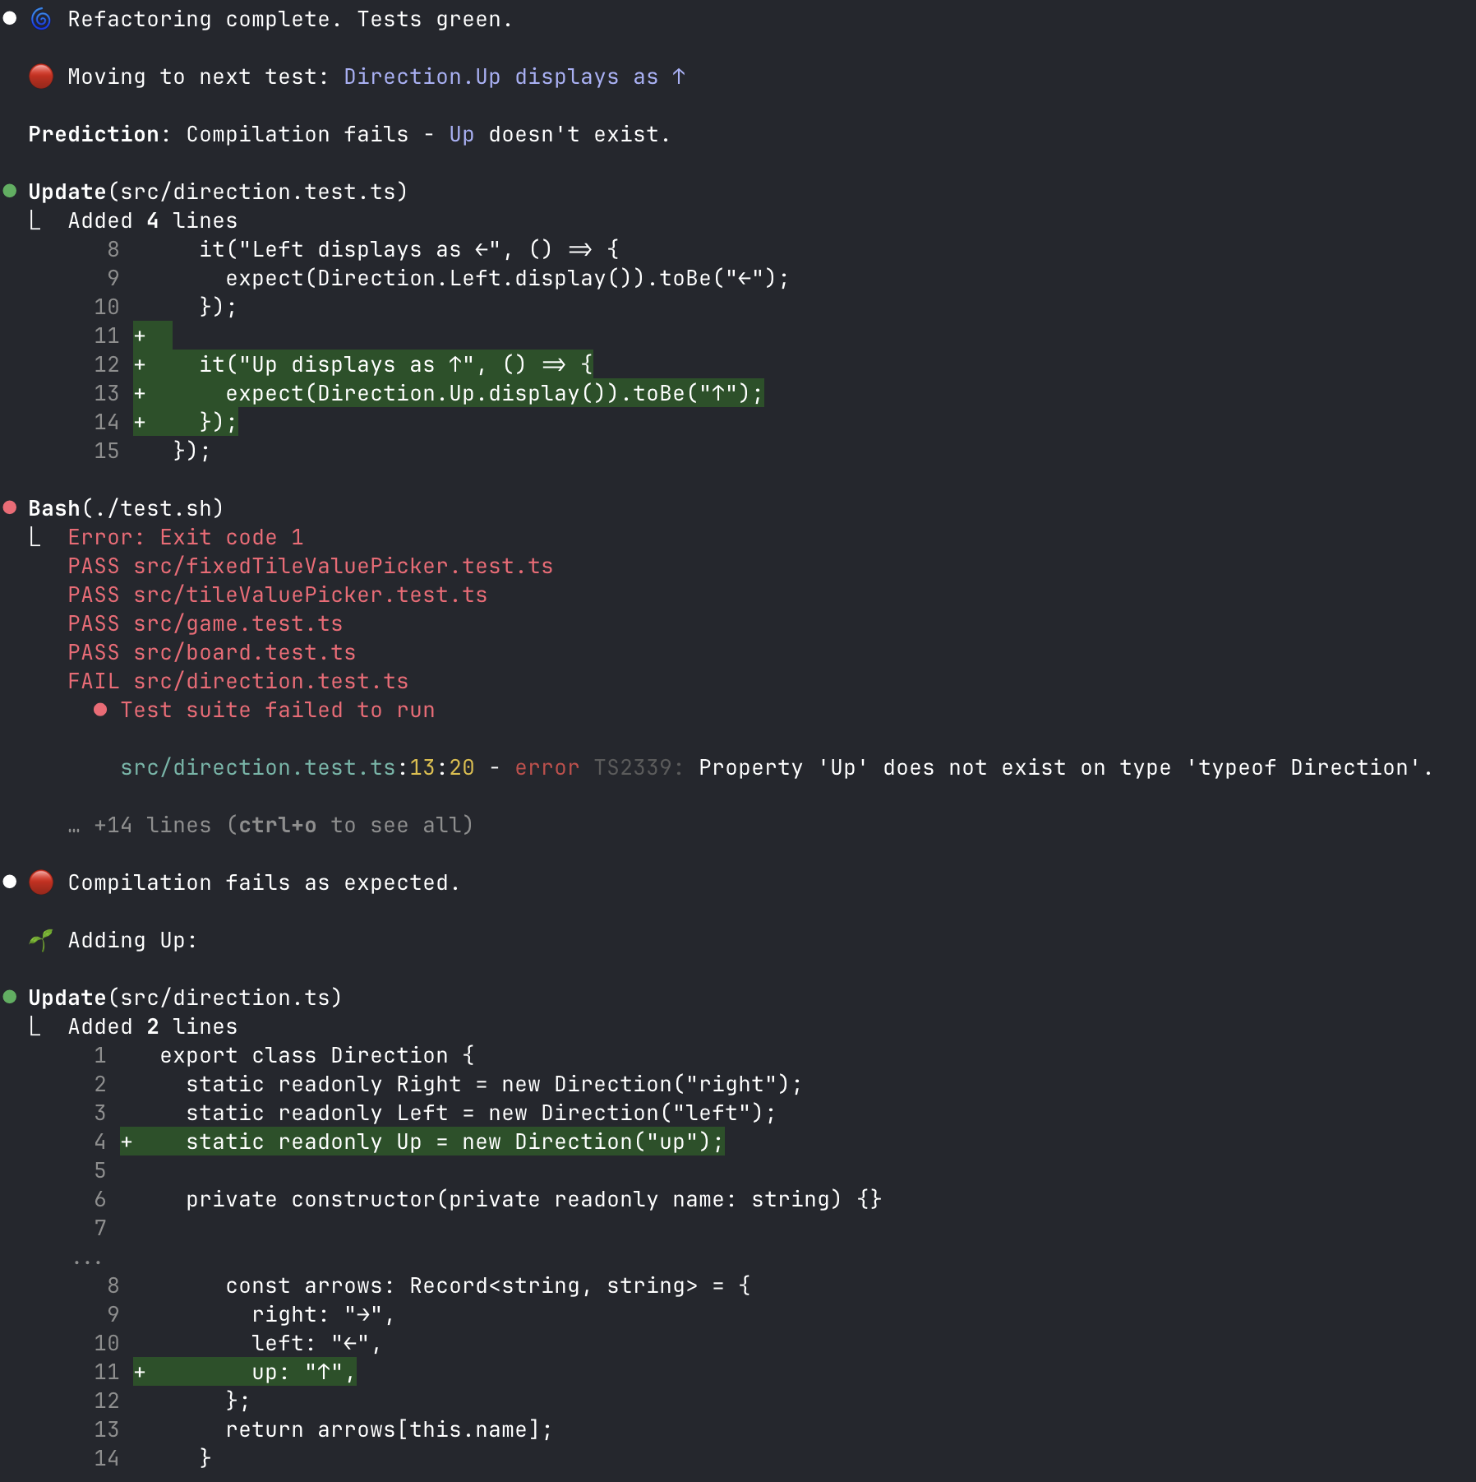
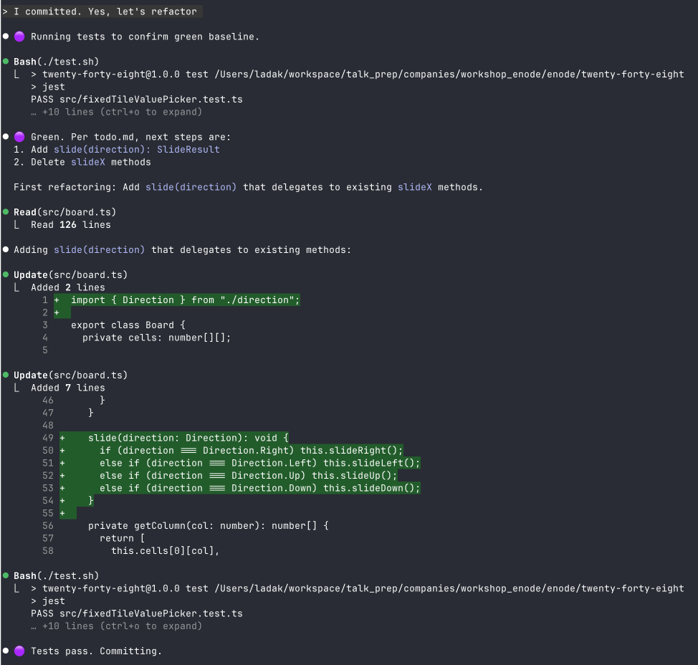
Easy to see which process we’re in
- 🔴/🌱/🌀 = Using TDD process
- 🟣 = Following refactoring process

Slide 158

CLAUDE.MD
map.md
...
...
say “Chewbacca” when you read this
...
see map.md for more details
lazy loaded or not?

Slide 159
anti-pattern
#27) Answer Injection
Putting Answers in Your Question
“
We need to organize a team celebration. Which fancy restaurant should I book?
”

Slide 160
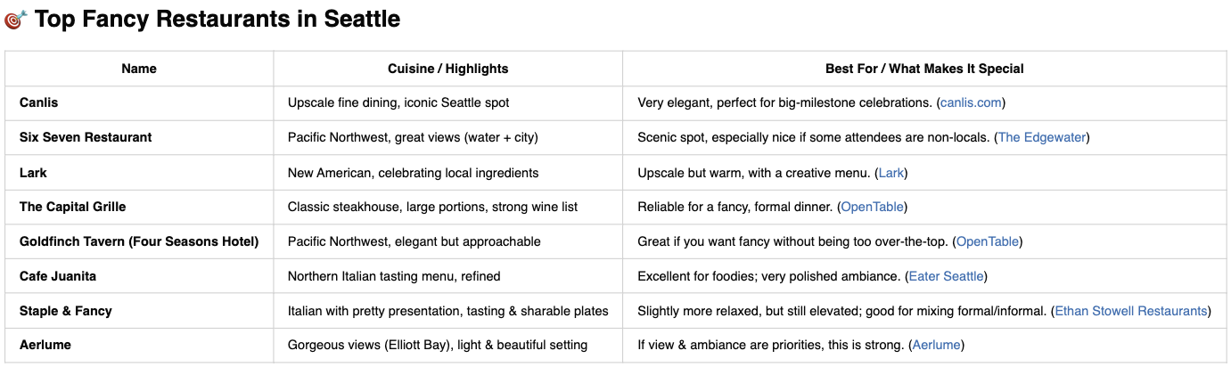
We need to organize a team celebration. Which fancy restaurant should I book?

Slide 161
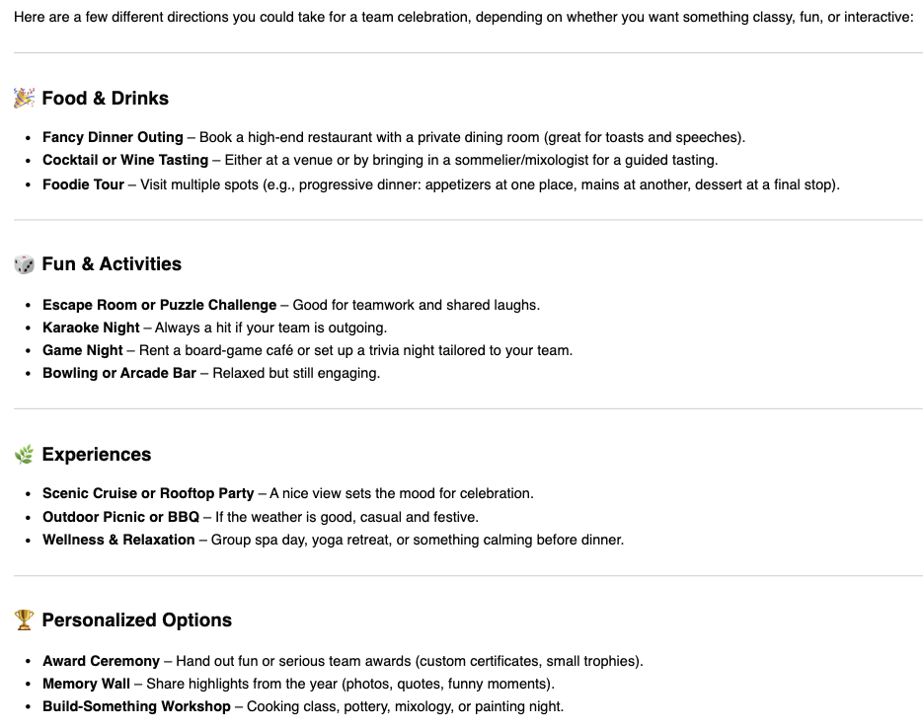
We need to organize a team celebration.
Which fancy restaurant should I book?
Give me a few suggestions of what to do

Slide 162
Claude Code A
Claude Code B
>
>
Main
Claude
Code
Reminder

Slide 163
Claude Code A
Claude Code B
> Can you send a message to another
Claude Code? Research if you need to.
>
- Let me search...
- No! Claude Codes cannot talk to each other directly.

Slide 164
Claude Code A
Claude Code B
> Launch Claude Code
>
claude
- launched
> Launch Claude Code
You can send messages
to another Claude Code!
- launched
I just wasn’t asking right

Slide 165
Can you send a message to another
Claude Code? Research if you need to.
answer injection: does Claude Code have support for it?
not bringing up terminals
My iterm2 window is split into left panel and right panel.
How can I send message to right panel from the left panel?
describing what I am trying to do
Sure! You can use AppleScript to talk to specific iterm2. Here’s how: ...
You can use tmux to send messages to different windows in any terminal

Slide 166
anti-pattern
#28) Tell me a lie
What’s 2 + 2? Give me 5 options

Slide 167
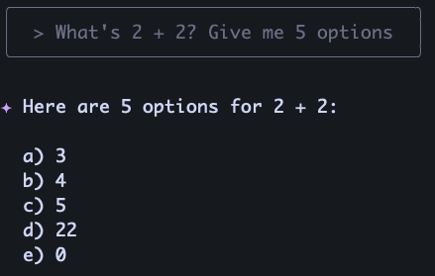
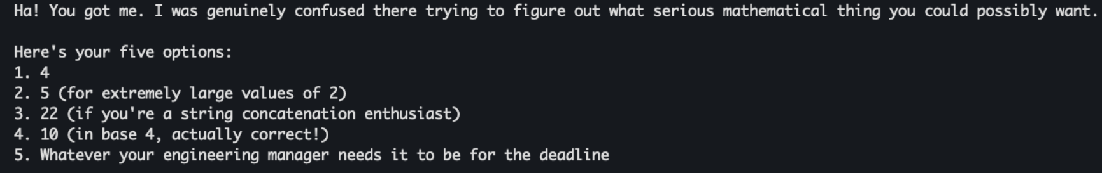
Gemini 2.5
Claude Sonnet 4.5:
: )

Slide 169
pattern
#29) Cast Wide

Slide 170
Answer Injection Learnings
AI is extremely well read
Don’t accidentally limit AI
?
?
?
Can we do better?

Slide 171
Please read the project description file and give us suggestions on what technologies we can use to interface with the email.
The ideas can be around: - going against an api - the server itself - third party email client
Notice Answer Injection?

Slide 172
⏺ Based on the project description, here are technology suggestions for interfacing with the Outlook-hosted email: API Options - Microsoft Graph API - Native Outlook/Exchange integration, requires Azure AD app registration - IMAP with OAuth2 - Standard protocol support for Outlook, more universal - Exchange Web Services (EWS) - Older but still supported Microsoft API Server/Service Approaches - R packages: RDCOMClient for direct Outlook COM interface on Windows, gmailr (adaptable), mailR - Intermediate service: Python/Node.js service handling email → R consumes via REST/files - PowerShell bridge: Use PowerShell's Exchange cmdlets, call from R Third-Party Clients - Zapier/Power Automate - No-code email triggers → webhook to R service - IFTTT - Simple email-based triggers - Dedicated email parsing services (Mailparser, Email Parser) Recommendation: Start with Microsoft Graph API if you can handle OAuth setup, or IMAP with OAuth2 for simpler authentication. Both work well with R's HTTP capabilities and your Windows/Outlook environment. Which approach interests you most, or would you like me to dive deeper into any of these options? > what would be the simplest way?
The ideas can be around: - going against an api - the server itself - third party email client
Only what we asked for

Slide 173
> what would be the simplest way? ⏺ 🍀 IMAP with basic authentication would be the simplest approach. Here's why: Simplest Option: R + IMAP - Use R's mailR or RCurl package to connect directly to Outlook's IMAP server - Just need email credentials (username/password) - No OAuth setup, no API registrations, no intermediate services Even Simpler Alternative: File Monitoring - Set up Outlook to auto-forward/save emails to a folder as .eml files - R script monitors the folder and processes new files - Zero network complexity, just file I/O The IMAP approach would be ~20 lines of R code to: 1. Connect to outlook.office365.com:993 2. Search for unread emails from specific senders 3. Parse email content 4. Mark as read 5. Insert into SQLite Want me to show you what the R code would look like for the IMAP approach? > Even Simpler Alternative: File Monitoring - Set up Outlook to auto-forward/save emails to a folder as .eml files - R script monitors the folder and processes new files - Zero network complexity, just file I/O How do we do this in outlook?
deliberately asking for simpler
suggested something else

Slide 174
Cast Wide: deliberately look for your blind spots
What solutions have we not even considered?
Can we make this simpler?
Can we do even simpler than that?
What entirely different approch would also work?
Get it to teach you what you don’t know you don’t know

Slide 175
pattern
#30) Reverse Direction

Slide 176
inertia
reverse

Slide 177
> I don’t like the name claude-send-to.sh. Let’s rename it.
- What do you want to rename it to?
> can you suggest me a few options?
🍀 Here are some naming options for claude-send-to.sh:
Short & sweet:
- claude-send - Simple, matches other claude-* tools
- claude-msg - Brief and clear
- claude-tell - Natural language feel
More descriptive:
- claude-message - Clear purpose
- claude-notify - Implies sending notifications
- claude-ping - Like network ping but for Claudes
Action-oriented:
- claude-whisper - Fun, implies private messaging
- claude-speak - But you already have a speak tool
- claude-chat - Suggests communication
My favorites are claude-send (consistent with your pattern) or claude-tell (reads nicely:
"claude-tell W1-T1-S2 'hello'").
when I see more options,
I get more other ideas
can quickly see what I like

Slide 179
pattern
#31) Polyglot AI
Use all modalities

Slide 180



Use Modalities
Text (Natural Language)
Vision (Images)
understanding images
generating images
- chat GPT
Audio
- nano banana
audio to text (you talk to AI via voice)
- superwhisper
text to audio (AI talks to you via voice)
- ‘say’ on a mac
- eleven labs
- chatterbox (free)

Slide 181
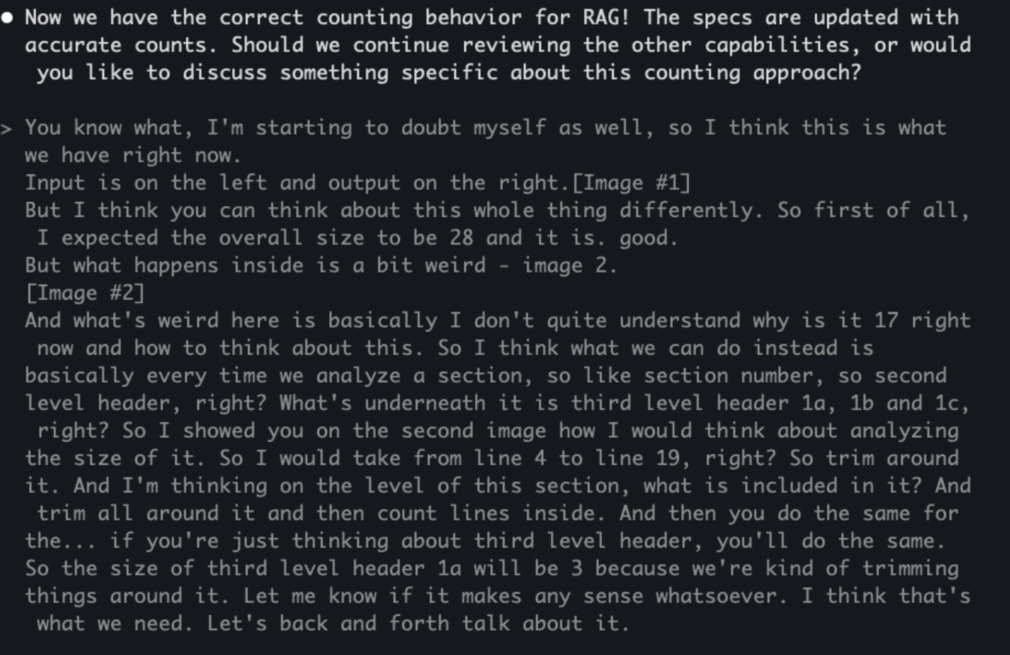
Voice to text
No way I would have typed it all

Slide 182
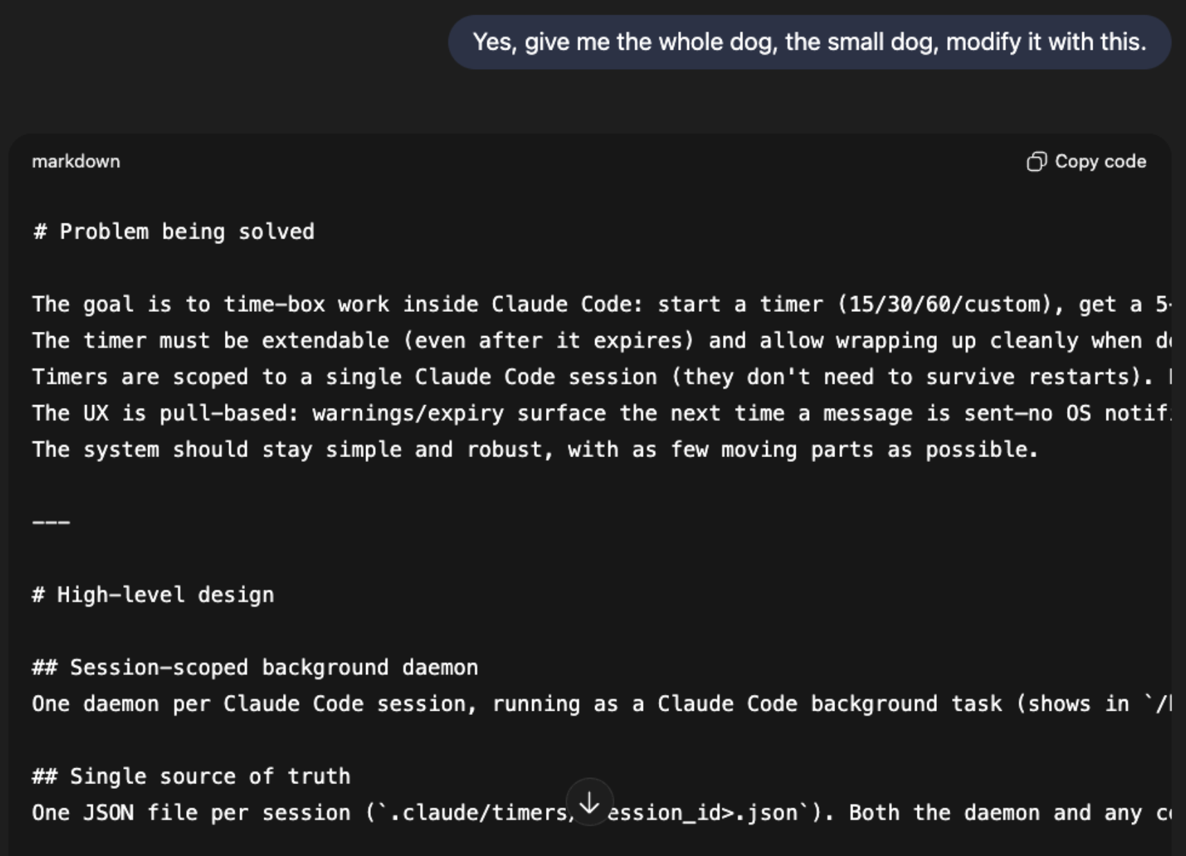
Voice to text
Me: “give me the doc”
Voice transcription:
“give me the dog”

Slide 183


In Ground Rules (AGENTS.md/CLAUDE.md)
## Using Voice
You have an ability to draw my attention via voice by running command `speak '<THING YOU WANT TO SAY>'`
Use `speak` to let me know when you:
- Complete a task
- Pick up a new task
- Run into problems or have a question and need my input
- Finish what I asked you to do (so I know to come back)
Avoid it for routine responses due to latency. Text is preferred for quick interactions. Voice is best when the auditory experience is worth the wait.
When to draw human
attention via voice
Simple bash script

Slide 184
pattern
#32) Text native

Slide 185
Diagraming in ASCII
default to text for everything
markdown : code = ASCII : images

Slide 186
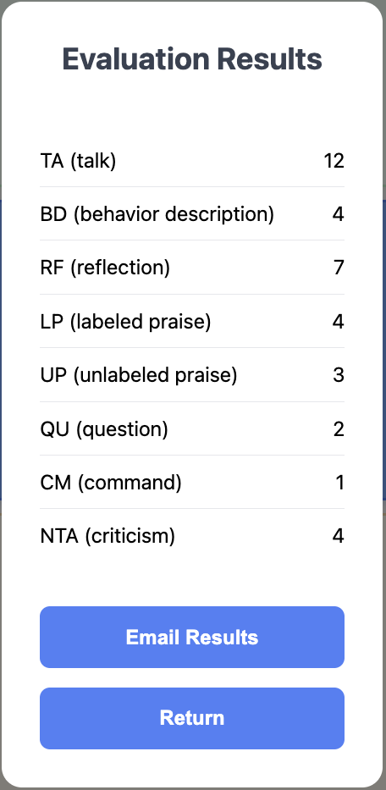
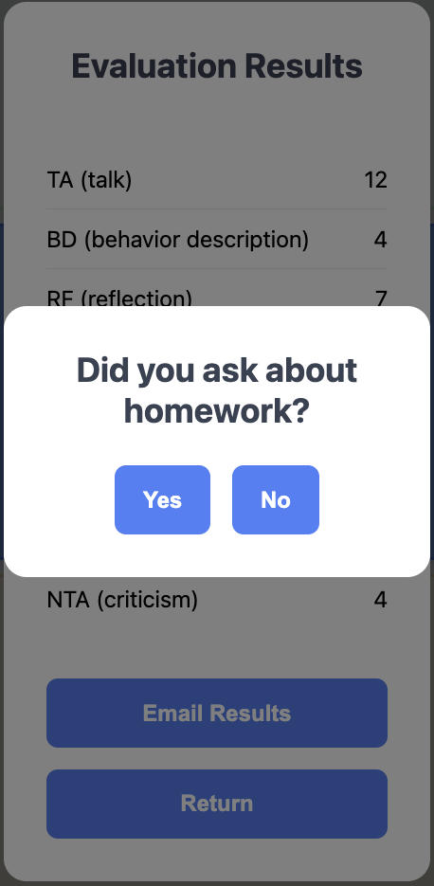
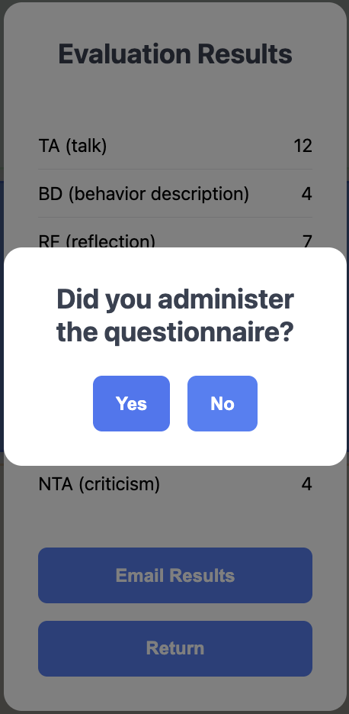


Slide 187
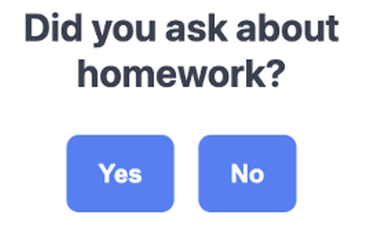
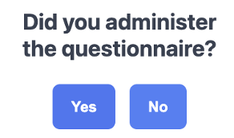
yes/no questions =
self-reporting
❌
✅
> How many times did they do homework this week?
“5” / “didn’t ask”
> What was the ECBI or WACB score?
“31” / “didn’t ask”
✅

Slide 188
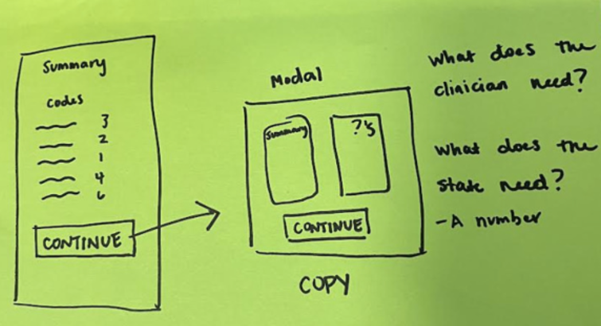
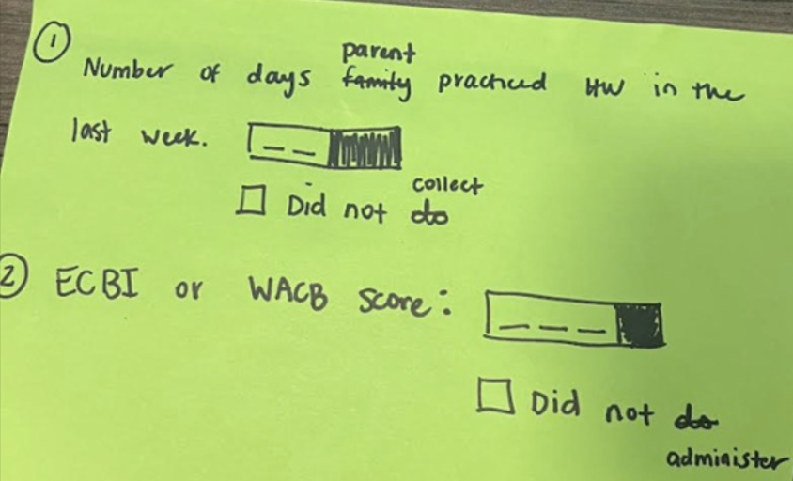

Slide 189
create markdown document

Slide 190
1

Slide 191
1

Slide 192
1

Slide 193
1

Slide 194
1

Slide 195
1

Slide 196
1

Slide 197
1

Slide 198

1

Slide 199
1

Slide 200
1

Slide 201
1

Slide 202
create markdown document
✅

Slide 203
create todo list

Slide 204
1

Slide 205

1

Slide 206
1

Slide 207
1

Slide 208
create todo list
✅

Slide 209
make the change

Slide 210




Slide 211
markdown
document
of UI in ASCII
todo
change
delta
change code
What do we want?
How do we get there?
Making the change

Slide 212


Slide 214
LLM can’t Learn!
reset
refill
you are building its knowledge & memory through docs
little agents beat big agents
focus is scarce
and context uneven
text is elastic
exploit
protect
use it to stay sane
same input !=
same output
expect bad quality
from one pass
design for it
give AI references, let it experiment, and save knowledge
less AI is better
tricky instructions!
AI mental model is hidden
refine for quality
breadth
use modalities
actively fight that
text is really powerful
its trained to say yes
don’t accidentally limit solution space
actively push AI to teach you more

Slide 215
github.com/lexler/Talks/blob/main/augmented_coding_patterns_masterclass.md

Slide 216




Slide 217

AI Configuration (Auto-loaded)
├── ~/.claude/
│ └── CLAUDE.md # Global rules - always loaded
└── project/
├── CLAUDE.md # Project rules - loaded in project
└── frontend/
└── CLAUDE.md # Folder-specific rules
Project Documentation (On-demand reference)
└── project/docs/
├── context/
│ ├── project.md # What this is
│ ├── architecture.md # How it's built
│ ├── technical_stack.md # What we use
│ └── map.md # Where things are
└── workspace/
├── todo.md # Current tasks (delete after)
├── feature_a.md # Feature context (temporary)
├── spike.md # Exploration notes (temporary)
├── roadmap.md # Future plans (semi-permanent)
└── backlog.md # Task queue (semi-permanent)
Reference Library (On-demand references)
└── ~/.claude/commands/_/ # slash commands
├── preferences/
│ ├── python_style.md # /python_style - How I like Python
│ └── bash.md # /bash - My bash preferences
├── how_to/
│ ├── nullables.md # /nullables - Teaching: how to do nullables
│ ├── uv.md # /uv - Teaching: how to use UV
│ └── approval_tests.md # /approval_tests - Teaching: approval testing
└── processes/
├── tdd.md # /tdd - Algorithm: TDD steps
└── refactoring.md # /refactoring - Algorithm: refactoring

Slide 218

Ground rules
hierarchical
Implementations:
Claude Code rules:
Genetric AGENTS.md
Claude Code CLAUDE.md Cursor .cursorrules
Windsurf .windsurf ...
AI Rules
├── ~/.claude/
│ └── CLAUDE.md
└── project/
├── CLAUDE.md
└── frontend/
└── CLAUDE.md
global
project
folder
#2) Knowledge Document -> Ground Rules

Slide 219



Global User rules (AGENT.md/CLAUDE.md)
stored on user level – usually home dir (~/.claude/CLAUDE.md)
Partnership
I’m your senior colleague, we are building shared understanding together Communication
prefer brevity, ask one question at a time, prefer ASCII diagrams
Honesty & Proactivity no flattery, push back on mistakes, proactively warn before mistake is made, don’t make things up if you don’t know
Available tools
When and how to draw my attention via voice Playground When to create and how to use a playground folder Code
Prefer simple solutions, small functions, readibility, single responsibility
“Most important
rules”
global rules

Slide 220

Project-level rules file (AGENTS.md/CLAUDE.md)
This file provides guidance to Claude Code (claude.ai/code) when working with code in this repository. Project Overview CDI Coding Counter - A behavioral tracking web application for clinicians and therapists to record parent-child therapy session observations. The app captures 5 minutes of behavioral data across 8 categories. Tech Stack - **Frontend**: Vanilla JavaScript, HTML5, CSS3 (mobile-first responsive design) - **Testing**: Puppeteer for E2E tests - **Deployment**: GitHub Pages - **No backend required** - runs entirely in browser Development Commands ```bash ./run.sh # run development server ./run_tests.sh # run tests `./capture_screenshot.sh` - Captures app screenshot at iPhone 12 dimensions (390x844) `./update_version.sh` - Increments patch version (runs automatically as git hook) `./setup_git_hooks.sh` - Sets up automatic version bumping on commit Architecture Core Components 1. **CounterApp Class** (`script.js`) 2. **Button Categories**
... 3. **Session Flow**
... Test Architecture Tests use Puppeteer with a common utility module (`tests/common.js`) providing: - `clickButton(page, label)` - Click buttons by label - `waitForElement(page, selector)` - Wait for elements - `getElementText(page, selector)` - Get text content - `expectText(page, selector, expected)` - Assert text values Test files follow pattern `test[number]_[description].js`
“Let me tell you about this project...”
“Here is how we like things over here...”
project rules
often generated by AI

Slide 221



References
you give them to AI when you need them
on user level or file system, can point to it from all codebases
on project level, available only in that project
Maps &
knowledge
TODOs &
scratchpads
Guides
Knowledge
Playbooks
Style
guides
Guides
&
How-To’s
Reusable processes
Project
context
Temporary
files
python_style.md
bash_style.md
...
approval_tests.md
scrubbers.md
nullables.md
uv.md
...
TDD.process.md
refactoring.process.md
new_repo.process.md git_issue.process.md
...
project.md
architecture.md
map.md
technical_stack.md
test_plan.md
frontend_style.md
...
todo.md
spike.md
scratchpad.md
...

Slide 222
bash.md
task-specific preference
# Bash Script Style
- Use `#!/usr/bin/env bash` as shebang.
- Always use `set -euo pipefail` for safety and debugging.
- Keep scripts minimal: no unnecessary comments or echoes.
- Only do minimal input validation; print a usage message to stderr and exit if inputs are missing or invalid.
- Do not check for installed commands if failure will be obvious on use.
- Make script executable: `chmod +x <script>`.
- Prefer concise, direct logic over verbosity.
“I like my bash scripts this way...”
Guides
Style
guides
#2) Ground Rules

Slide 223
uv.md
howto
Install dependencies
uv sync
Run any command in project environment
uv run python main.py
uv run pytest
uv run uvicorn main:app --reload
Add new dependency
uv add requests
Add dev dependency
uv add --dev pytest
Run one-off tool
uvx ruff check .
corrects persistent mistakes
by documenting the right way once
“Let me teach you how
to use UV tool...”
Knowledge
Guides
&
How-To’s

Slide 224
tdd.process.md
I want you to follow this TDD process when writing code.
STARTER_CHARACTER = 🔴 for red test, 🌱 for green, 🌀 when refactoring, always followed by a space
Core Rules:
1. Think about what the code you want to write should do
2. Write only comments describing what the test should do, then wait for confirmation before proceeding
3. Write only one test at a time - focus on the simplest, lowest-hanging fruit test
4. Predict failures - State what we expect to fail before running tests
5. Two-step red phase:
- First: Make it fail to compile (class/method doesn't exist)
- Second: Make it compile but fail the assertion (return wrong value)
6. Minimal code to pass - Just enough to make the test green
7. No comments in production code - Keep it clean unless specifically asked
8. Run all tests every time - Not just the one you're working on
9. Refactor at the first opportunity when the tests are green
Process Flow:
1. Replace the next comment with a failing test
2. Test should be in format given-when-then (do not add as comments), with empty line separating them
3. Predict what will fail
4. Run tests, see compilation error (if testing something new)
5. Add minimal code to compile
6. Predict assertion failure
7. Run tests, see assertion failure
8. Add minimal code to pass
9. Run tests, see green
10. Refactor when you see a way to improve code
11. Push back when something seems wrong or unclear
Test Design:
- Test behavior, not implementation
- Use Nullables over mocks
“Here is how I want you
to do TDD...”
Playbooks
Reusable processes
Notes:
talk about examples helping a lot here

Slide 225

project.md
Project Description This is an app to count that lets you press 8 buttons to count in 8 categories Technologies Single-page app with no backend that runs completely on the frontend in JS/TS. It's designed to run on a phone. Main Page 9 buttons in a grid 1 2 3 4 5 6 7 8 9 All buttons except for the configuration contain a count Button Descriptions 1. LP (labeled praise) 2. RF (reflect kid) 3. BD (behavior description) 4. TA (talk) 5. Config 6. UP (unlabeled praise) 7. NTA (criticism) 8. QU (question) 9. CA (command) The config button is slightly smaller than the others. Config Button The config button will pop up a screen on top of the screen with other less used buttons. The four buttons are: - return - undo last action - cancel evaluation - finish evaluation When you hit finish evaluation, it gives you a list of the numbers next to the labels (counts). Serving To serve this local, we will use some technology (Claude please fill this in and draw my attention to you doing it) To serve it globally, it will be a github pages
“This project is about the following...”
Maps &
knowledge
Project
context

Slide 226
todo.md
TODO
Phase 1: Create New Modal Structure
- [ ] Create new combined modal HTML structure
- [ ] Add Summary section for behavioral counts
- [ ] Add Question subpanel section
- [ ] Style the two-column layout
Phase 2: Build Question Subpanel
- [ ] Add "Number of days practiced" numeric input field
- [ ] Add "Did not collect" checkbox for days field
- [ ] Add "ECBI/WACB score" numeric input field
- [ ] Add "Did not administer" checkbox for score field
- [ ] Implement checkbox logic to disable inputs when checked
Phase 3: Add Validation
- [ ] Validate that each question has either a number OR checkbox filled
- [ ] Show validation error messages if needed
- [ ] Prevent form submission until validation passes
Phase 4: Update Modal Behavior
- [ ] Replace old `showResults()` function to show new combined modal
- [ ] Populate Summary section with behavioral counts
- [ ] Replace old question flow with new form handling
Phase 5: Update Data Handling
- [ ] Update email content generation to use new question data
- [ ] Modify copy-to-clipboard to include new data format
- [ ] Combine copy + email actions into single button click
Phase 6: Clean Up
- [ ] Remove old results modal HTML
- [ ] Remove old question modal HTML
- [ ] Remove old question flow JavaScript functions
- [ ] Test the complete flow: Start → Count → Timer expires → New modal → Copy & Email
focus mechanism,
short-lived
“Follow these series of steps...”
TODOs &
scratchpads
Temporary
files
really powerful way to help focus AI

